Slide 1
1
SPORT AND EUROPEAN UNION LAW
From Bosman to RRC Sports
Michele Colucci
www.colucci.eu - info@colucci.eu

Slide 2

THE EUROPEAN UNION: 27 Member States - 1 Single Market
2
Part I : Why and when does EU law apply to sport?
Part II :Free movement of workers:from Bosman to Diarra
Part III : Competition law: Meca-Medina and the control of regulatory power
Part IV :Superleague, Seraing, ROGON and RRC Sports
Final question : What kind of autonomy does modern sport need?
Sport within the European Union legal order

Slide 3
3
The central question
How far can sports governing bodies regulate
their sport without infringing EU law?

Slide 4
Why EU law applies to sport?
4
Sport falls within EU law when it constitutes an economic activity.
Rules adopted by private sports associations can be subject to Treaty rules.
Sporting objectives and specific characteristics matter, but they do not create a general exemption from EU law.
Article 165 TFEU requires the EU to take account of the specific nature of sport.
Treaty framework: Articles 45, 49, 56, 101, 102 and 165 TFEU.

Slide 5
The EU law framework
5
Article 45 TFEU : free movement of workers
Articles 49 and 56 TFEU :establishment and services
Article 101 TFEU :restrictive agreements and decisions of associations of undertakings
Article 102 TFEU : abuse of a dominant position
Article 47 Charter + Article 19(1) TEU — effective judicial protection
Article 165 TFEU :specific nature of sport

Slide 6
A recurring structural problem
6
Sports governing bodies make rules that organise competitions.
They may also organise and commercialise competitions themselves.
Their rules can determine access to markets, employment and professional activity.
EU law therefore asks not only what objective is pursued, but also how regulatory power is exercised.

Slide 7
7
PART I — FREE MOVEMENT OF WORKERS
Bosman is the natural starting point

Slide 8
Article 45 TFEU : FREE MOVEMENT
8
Professional athletes can be ‘workers’ for EU law purposes and they are free to move within the territory of the European Union: NO OBSTACLES!
Article 45 prohibits nationality discrimination and restrictions capable of hindering access to employment in another Member State.
The rule may come from a private association if it collectively regulates gainful employment.
Key analytical question: does the sporting rule make cross-border employment less attractive or more difficult?

Slide 9
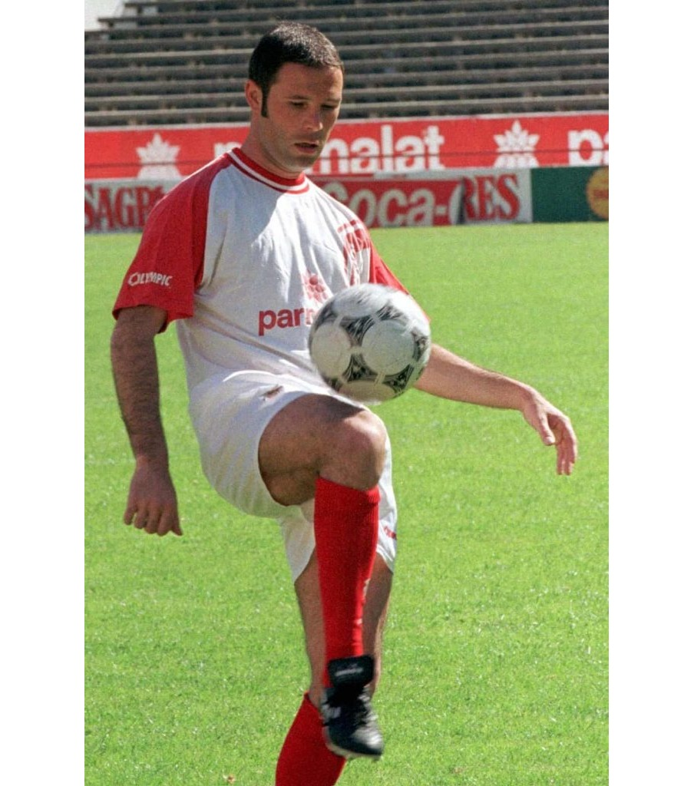
Bosman — the facts
9
Jean-Marc Bosman played for RFC Liège in Belgium.
His contract expired and he sought to join US Dunkerque in France.
Under the transfer rules then in force, his former club could still demand a transfer fee.
Salary equal to 1500 euros per month
Requested transfer fee 200,000 euros
The dispute also challenged UEFA nationality quotas limiting the number of foreign EU players fielded by clubs.
Jean-Marc Bosman
Court of Justice, C-415/93, Bosman, judgment of 15 December 1995.

Slide 10

Bosman — the legal questions
10
Can Article 45 apply to rules adopted by football associations?
Can a transfer system restrict free movement even if it applies without nationality discrimination?
Can nationality clauses limiting EU players be maintained on sporting grounds?
The post-contract transfer system challenged in Bosman
C-415/93, Bosman.

Slide 11
Bosman — the ruling
11
CASE STUDY
COURT'S ANSWER
DATE
15 December 1995
EU LAW
Article 45 TFEU (then Article 48 EC)
The post-contract transfer rules constituted an obstacle to free movement.
Nationality clauses limiting EU nationals in club competitions
were incompatible with the Treaty.
WHY IT MATTERS
Private sporting rules cannot restrict Treaty rights simply because they are
adopted within sport.
The judgment reshaped the European football labour market.
Court of Justice, C-415/93, ECLI:EU:C:1995:463.

Slide 12
Bosman — restriction, not only discrimination
12
The transfer rules were not unlawful only because of nationality.
The key point was their capacity to impede a player's access to employment in another Member State.
This moved the analysis beyond a narrow prohibition of direct discrimination.
Sporting rules may therefore be caught even when they apply formally to everyone.
C-415/93, Bosman.

Slide 13
Can restrictions be justified?
13
Bosman did not establish that every sporting restriction is unlawful.
Legitimate sporting objectives can be relevant.
The measure must still be suitable and proportionate.
Examples in later case law include competitive balance, regularity of competitions and the training of young players.

Slide 14

After Bosman: three useful cases
14
Lehtonen (C-176/96): transfer deadlines may restrict movement, but can protect the regularity of competitions.
Deliège (C-51/96 and C-191/97): selection criteria inherent in organising an international competition may comply with EU law.
Bernard (C-325/08): training compensation may encourage youth development, but it must reflect training costs and remain proportionate.
Kolpak and Simutenkov: association agreements can extend equal-treatment guarantees beyond EU nationals.
Youth training and proportionality: Bernard
Court of Justice: Lehtonen, Bernard, Kolpak and Simutenkov.

Slide 15
15
Almost 30 years after Bosman…
Can FIFA transfer rules still deter a player
from moving to another Member State?

Slide 16
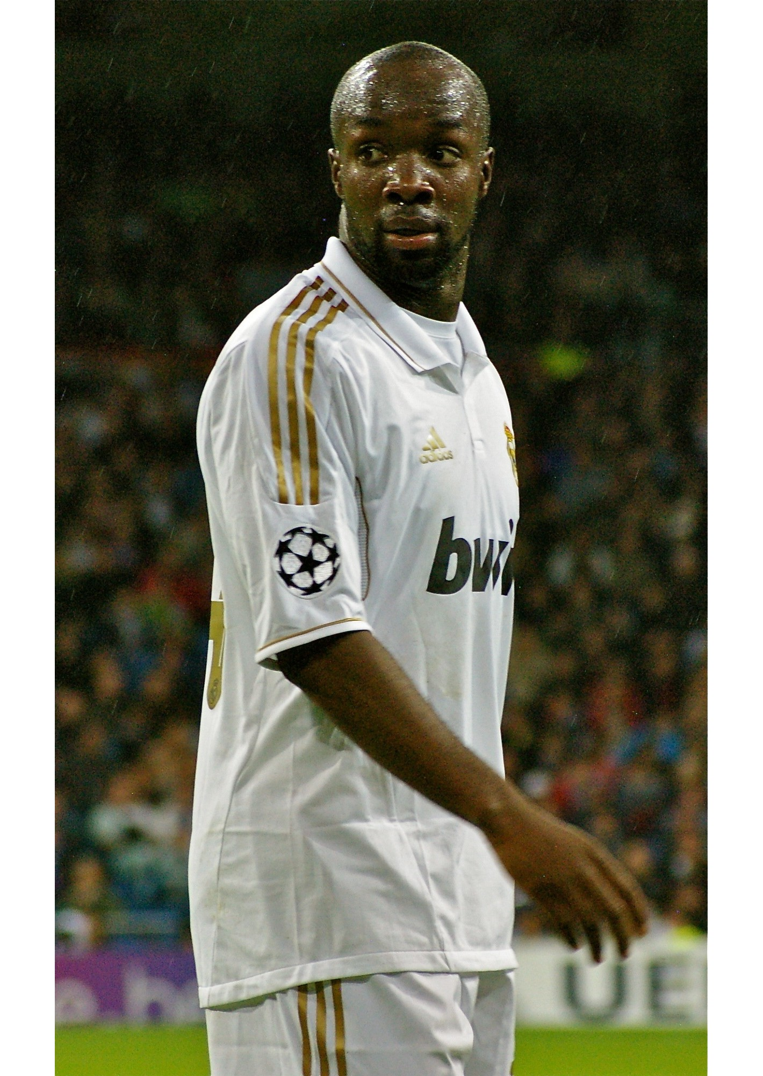
Diarra — the facts
16
Lassana Diarra terminated his contract with Lokomotiv Moscow.
Article 17 RSTP exposed the player and a new club to compensation, joint liability and sporting sanctions.
The ITC rules could prevent registration while a dispute remained pending.
The combined effect made recruitment legally and financially unpredictable.
The Diarra judgment, 4 October 2024
Court of Justice, C-650/22, FIFA, judgment of 4 October 2024.

Slide 17
Diarra — the ruling
17
COURT'S ANSWER
DATE
4 October 2024
EU LAW
Article 45 TFEU + Article 101 TFEU
The rules restricted Article 45 TFEU
It amounted to a restriction of competition
by object under Article 101 TFEU.
WHY IT MATTERS
- Imprecise compensation criteria,
- Automatic joint liability,
- Presumptions supporting sporting sanctions
- The ITC mechanism could ‘freeze’ the recruitment market.
Contractual stability remained legitimate,
but these means went beyond what was necessary.
Court of Justice, C-650/22, FIFA (Diarra).

Slide 18
Bosman → Diarra
18
FREE MOVEMENT
Bosman: a player whose contract had expired.
Diarra: a player whose contract was terminated without just cause.
Both cases examine rules that can deter a new club from recruiting the player.
The common principle: contractual stability is legitimate, but the regulatory means remain subject to EU law and proportionality.
C-415/93 Bosman; C-650/22 FIFA (Diarra).

Slide 19
19
PART II — FROM FREE MOVEMENT TO COMPETITION
The focus shifts from the movement of athletes to the exercise of regulatory power.

Slide 20
Articles 101 and 102 TFEU
20
COMPETITION
Article 101: agreements and decisions of associations of undertakings that restrict competition are null and void.
Article 102: no to abuse by one or more undertakings holding a dominant position.
Sports federations can qualify as associations of undertakings and may themselves carry out economic activities.
The legal analysis depends on the content, objective and economic and legal context of the rules.

Slide 21
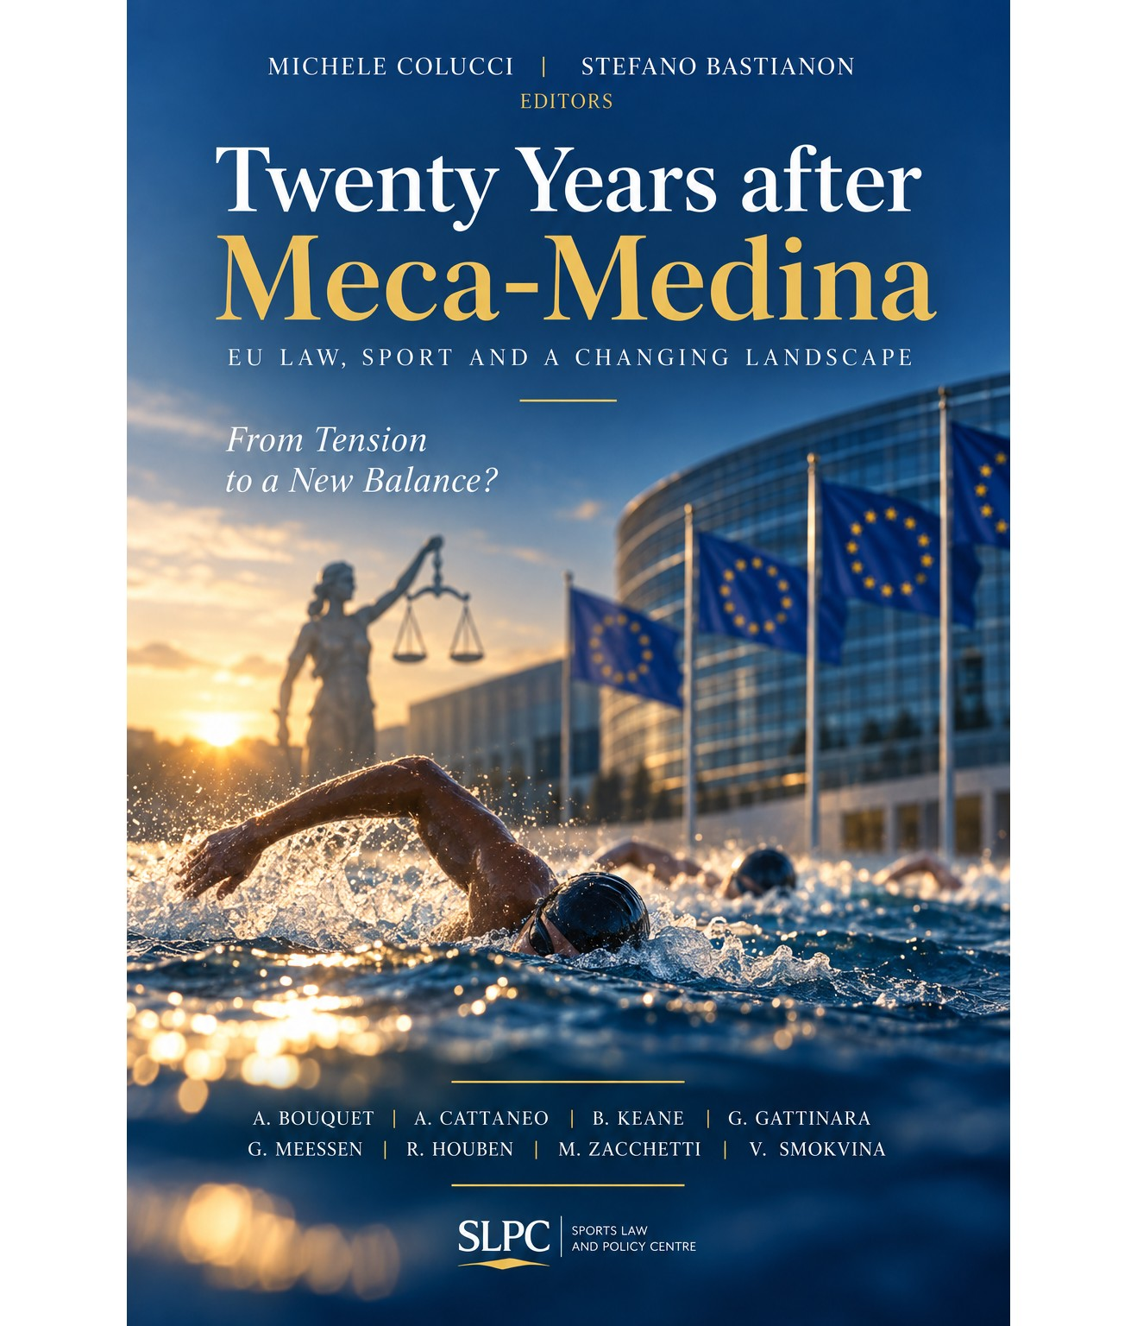
Meca-Medina — the facts
21
COMPETITION
David Meca-Medina and Igor Majcen, professional long-distance swimmers, tested positive for nandrolone.
FINA imposed four-year bans. The CAS reduced them to two years.
The swimmers challenged the anti-doping rules under Articles 101 and 102 TFEU.
The central issue was whether a rule described as ‘purely sporting’ could escape EU competition law.
Meca-Medina and Majcen: anti-doping rules under EU law
Court of Justice, C-519/04 P, judgment of 18 July 2006.

Slide 22
Meca-Medina — the ruling
22
CASE STUDY
COURT'S ANSWER
DATE
18 July 2006
EU LAW
Articles 101 and 102 TFEU
The economic nature of the activity brought the rule within EU law.
Its sporting character did not create an exemption.
WHY IT MATTERS
The anti-doping rules pursued fair competition and athletes' equal chances.
Their restrictive effects were inherent in that objective and, on the evidence before the Court,
proportionate.
The method, rather than the outcome, made the judgment foundational.
Court of Justice, C-519/04 P, ECLI:EU:C:2006:492.

Slide 23
The Meca-Medina method
23
COMPETITION
1. Identify the economic activity and the restriction.
2. Examine the overall context in which the rule was adopted or produces effects.
3. Identify the legitimate objective pursued.
4. Ask whether the restrictive effects are inherent in pursuing that objective.
5. Ask whether the restrictions are proportionate.
C-519/04 P, Meca-Medina.

Slide 24
What Meca-Medina did — and did not do
24
It did not abolish sports autonomy.
It did not make every restrictive sporting rule unlawful.
It rejected an automatic exclusion of sporting rules from competition law.
It made justification depend on the concrete relationship between objective, necessity and proportionality.
C-519/04 P, Meca-Medina.

Slide 25
25
SUPERLEAGUE
What happens when the regulator is also an economic operator?

Slide 26
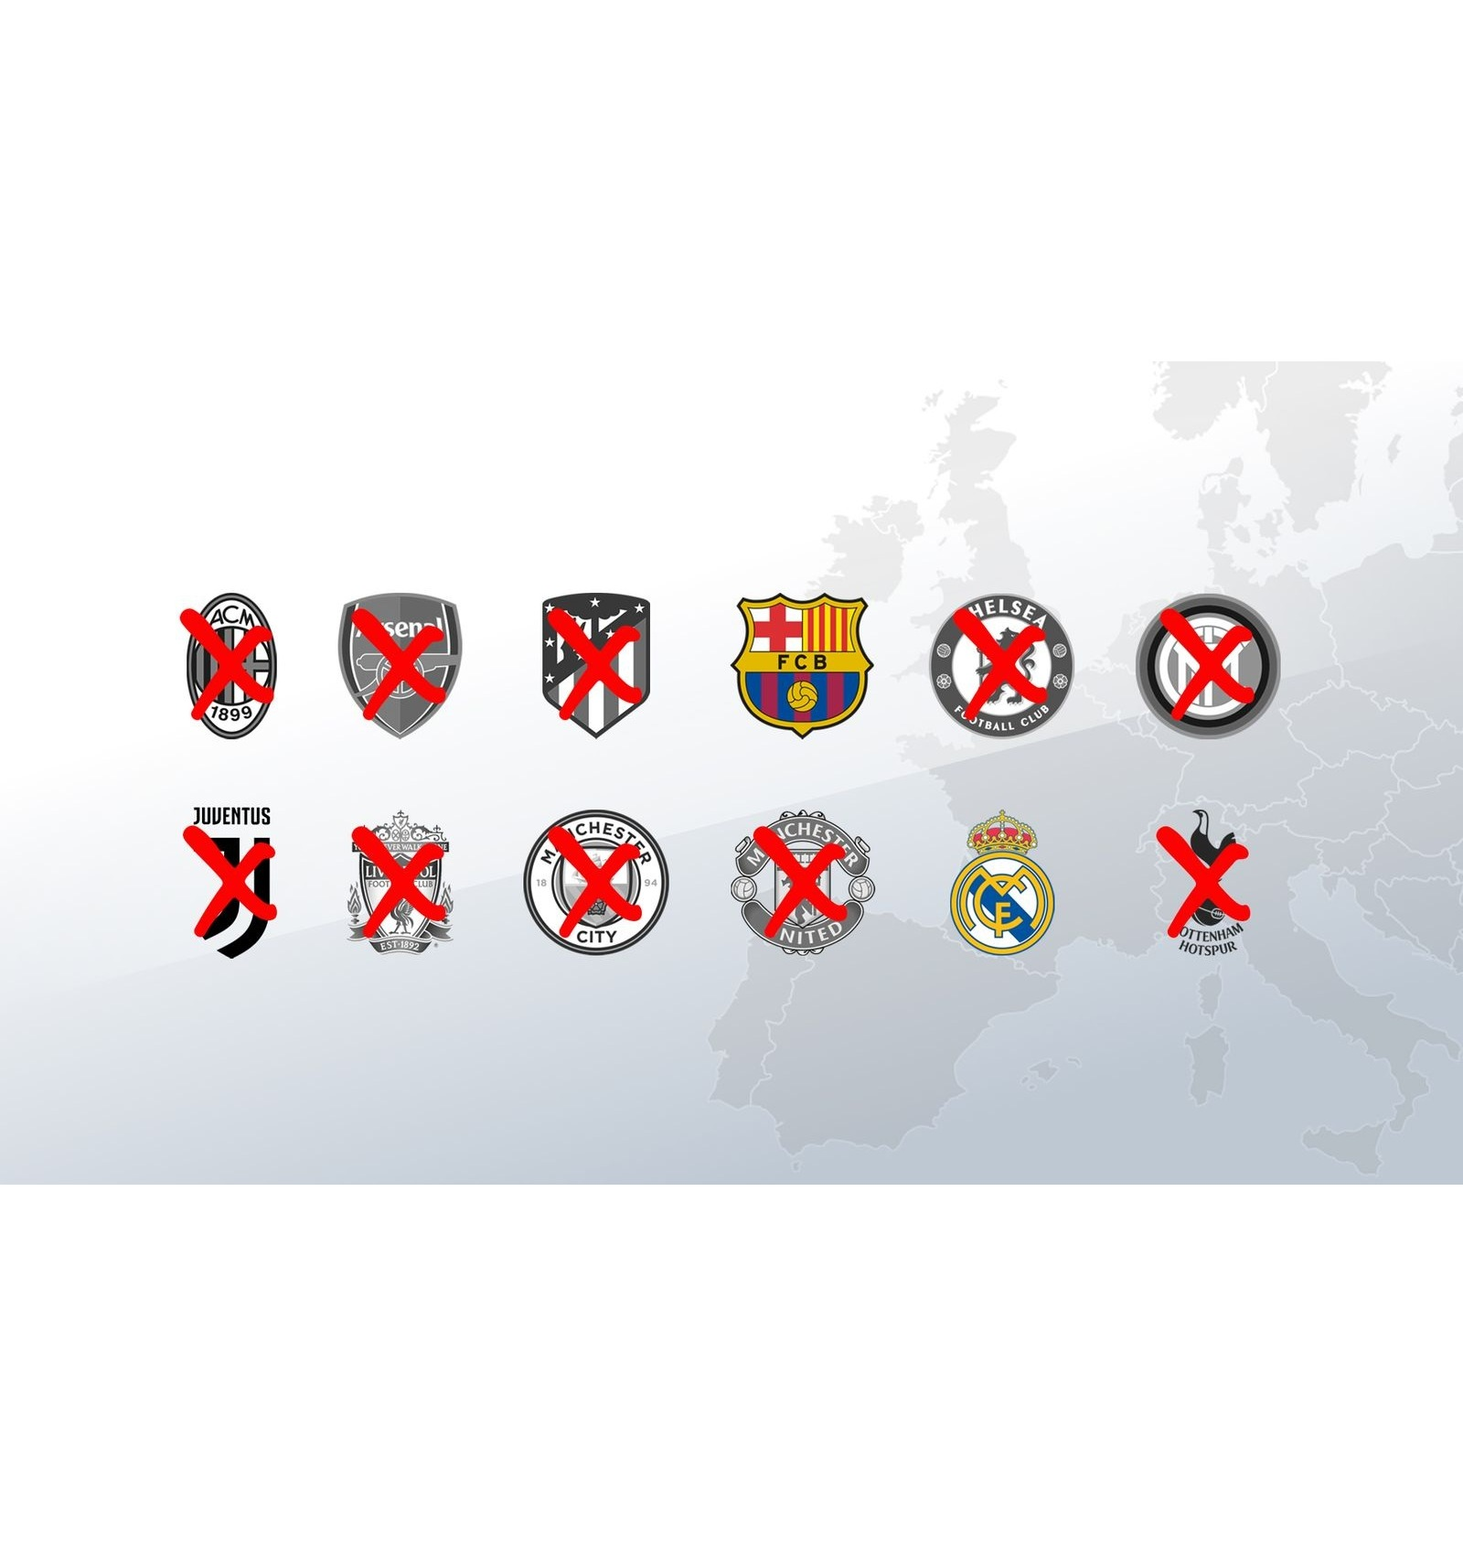
European Superleague — the structure of the dispute
26
FIFA and UEFA regulate international football.
They also organise and commercially exploit major football competitions.
Their rules required prior approval for new interclub competitions and allowed sanctions against clubs and players.
The dispute therefore concerned both regulatory power and market access.
The twelve founding clubs, the Super League's ‘Dirty Dozen’
Court of Justice, C-333/21, European Superleague Company, judgment of 21 December 2023.

Slide 27

Superleague — the Court's concern
27
Prior approval can serve legitimate aims, including common rules, sporting merit and coordination of the calendar.
The problem was FIFA and UEFA's dual role: they regulated market entry while organising and commercialising their own competitions.
EU law therefore required published substantive criteria and detailed procedures capable of constraining discretion.
The regulator also operates on the competition market
C-333/21, European Superleague Company.

Slide 28
Superleague — the ruling
28
CASE STUDY
COURT'S ANSWER
DATE
21 December 2023
EU LAW
Articles 101, 102 and 56 TFEU
The prior-approval and sanctioning rules infringed Articles 101 and 102 TFEU
because no framework ensured transparent, objective, precise, non-discriminatory and
proportionate decisions.
WHY IT MATTERS
The rules also restricted Article 56 TFEU. A legitimate authorisation system remained possible,
but only under published criteria, detailed procedures, proportionate sanctions and
effective review.
Court of Justice (Grand Chamber), C-333/21, ECLI:EU:C:2023:1011.

Slide 29

Superleague and ISU
29
COMPETITION
ISU and Superleague concern a sports body that acts both as regulator and organiser.
The Court did not treat that dual role as unlawful in itself. It focused on the uncontrolled power to authorise rival events and sanction participants.
The required safeguards include accessible criteria, detailed procedures, proportionate sanctions and effective judicial review.
ISU also anticipated Seraing:
compulsory CAS arbitration cannot remove access to effective EU-law review.
ISU: prior authorisation and sanctions
Court of Justice, C-124/21 P, ISU; C-333/21, European Superleague Company.

Slide 30
From Meca-Medina to Superleague
30
COMPETITION
Meca-Medina asks whether restrictive effects are inherent and proportionate to a legitimate objective.
Superleague focuses strongly on the structure and exercise of regulatory power.
Legitimate sporting objectives remain relevant.
But the regulator must operate within rules that constrain discretion and permit effective scrutiny.

Slide 31
31
SERAING
If sporting regulation is subject to EU law, who ensures effective judicial review?

Slide 32

Seraing — the path of the dispute
32
JUDICIAL PROTECTION
FIFA sanctioned RFC Seraing over third-party ownership arrangements.
The club challenged the sanctions before the CAS, then before the Swiss Federal Tribunal.
Belgian proceedings raised whether the CAS award could acquire res judicata or probative force without an EU court having reviewed compliance with EU public policy.
The structural question was simple: can compulsory sports arbitration insulate a decision from EU judicial review?
RFC Seraing and compulsory CAS arbitration
Court of Justice, C-600/23, Royal Football Club Seraing, judgment of 1 August 2025.

Slide 33
Seraing — the ruling
33
CASE STUDY
COURT'S ANSWER
DATE
1 August 2025
EU LAW
Article 19(1) TEU + Article 47 Charter
Where an international federation imposes arbitration,
Member State courts must retain effective power to review compliance with
EU public-policy rules.
WHY IT MATTERS
Courts must be able to disapply national rules on res judicata or probative value,
adopt interim measures and remedy infringements.
Swiss review cannot replace review by a court within the EU judicial system.
Court of Justice (Grand Chamber), C-600/23, ECLI:EU:C:2025:617.

Slide 34

Superleague → Seraing
34
JUDICIAL PROTECTION
Superleague: how must private regulatory power be exercised?
Seraing: how must decisions produced within that system remain reviewable?
Substantive accountability and judicial accountability are connected.
Autonomy does not mean insulation from EU law.
Effective judicial review must remain available in the EU
C-333/21 European Superleague Company; C-600/23 Royal Football Club Seraing.

Slide 35
35
2026 — FOOTBALL AGENTS
How far may sports federations regulate markets surrounding the sporting competition itself?

Slide 36
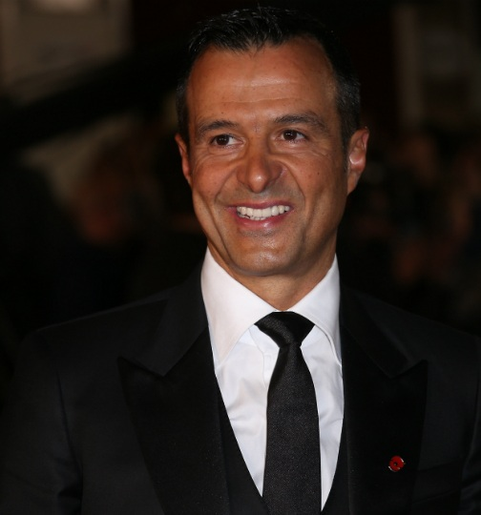
ROGON — third parties and the sporting ecosystem
36
The DFB regulated the use of football agents by clubs and players.
The rules covered registration, submission to federation rules, fees, disclosure and sanctions.
ROGON mattered because the regulated service providers were third-party undertakings rather than federation members.
The Court accepted that rules governing access to those services may pursue legitimate public-interest objectives, but required a close assessment of necessity and proportionality.
Jorge Mendes, founder of Gestifute
Court of Justice, C-428/23, ROGON and Others, judgment of 9 July 2026.

Slide 37
ROGON — the legal test
37
CASE STUDY
COURT'S ANSWER
DATE
9 July 2026
EU LAW
Article 101 TFEU
The Meca-Medina method may apply to rules affecting third-party undertakings
where the restriction is not by object.
WHY IT MATTERS
The national court must identify a legitimate public-interest objective and
verify that each restriction is appropriate, necessary and proportionate.
A restriction by object cannot benefit from that route.
Court of Justice, C-428/23, ROGON and Others; Press Release No 99/26.

Slide 38
RRC Sports — FIFA Football Agent Regulations
38
RRC Sports concerned the FIFA Football Agent Regulations: licensing, remuneration caps, multiple representation, approaches to clients and disclosure duties.
The case engaged Articles 101 and 102 TFEU, Article 56 TFEU and the GDPR.
The Court distinguished between provisions whose restrictive character followed from their object and provisions requiring an effects analysis.
Any justification still depended on evidence and proportionality.
Court of Justice, C-209/23, RRC Sports, judgment of 16 July 2026; Press Release No 110/26.

Slide 39
ROGON and RRC Sports — what do they add?
39
Sports regulation may reach economic operators outside the federation, but that reach requires legal justification.
Competition law, free movement of services and data protection can apply simultaneously to the same regulatory system.
The Court continues to recognise legitimate objectives: integrity, protection of players and coaches, ethical standards and avoidance of conflicts of interest.
The decisive issue remains whether the chosen restrictions satisfy the applicable EU-law conditions.
C-428/23 ROGON; C-209/23 RRC Sports.

Slide 40
40
FROM BOSMAN TO RRC SPORTS
1995
BOSMAN
Can sporting rules restrict the movement of players?
2006
MECA-MEDINA
When can restrictive sporting rules be justified?
2023
SUPERLEAGUE
How must regulatory power be exercised?
2025
SERAING
Who must be able to review that power?
2026
ROGON / RRC
How far may regulation reach into adjacent markets?
The issue is no longer whether EU law applies to sport.
The question is how sporting autonomy can operate within EU law.

