Slide 1
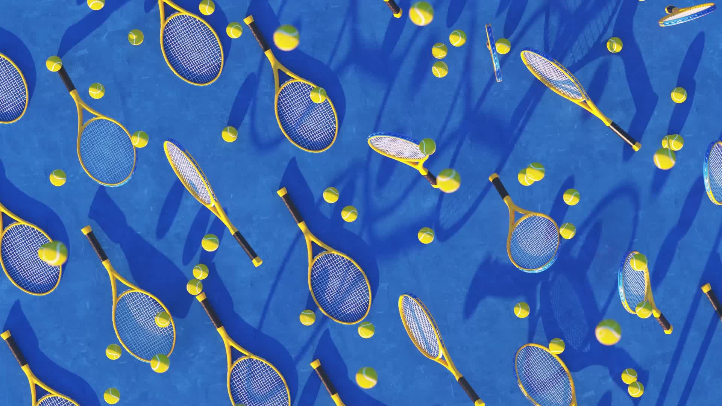
The Evolution of Sport at EU level In the name of Autonomy and Specificity of sport
MICHELE COLUCCI
www.colucci.eu
E-mail: info@colucci.eu

Slide 2
International sports cases before the EU judges D-DAY: 21 December 2023
Superleague against UEFA and FIFA
FC Antwerp against UEFA (homegrown player rule)
International Skating Union
Football Agents against FIFA (pending)
The Diarra case (pending)
The Seraing case (pending)

Slide 3
THE EUROPEAN UNION
27 Member States
47.000.000 people
4,233,255.3 km²
ONE SINGLE MARKET :
-FREEDOM TO MOVE
-TO PROVIDE SERVICES -AND TO COMPETE

Slide 4
How does the EU work?
The European Council
27 Heads of Governments
Political input
The European Parliament
Members from MSs
Legislative role
Budget
The Council of the European Union
Ministers from governments
Legislative role
Budget
The European Commission
DGs: Competition
Education and Culture (Sport)…
Arm of the EU: executory body
“Guardian” of the Treaties
Proposes legislation
The Court of Justice of the EU
Court of Justice
General Court
Uniform application and interpretation of the EU legislation

Slide 5
LEGAL SOURCES
PRIMARY LAW:
Treaty of the European Union
Treaty of the Functioning of the European Union
Charter of the EU Fundamental Rights
General Principles of EU Law
International Treaties TREATIES
SECONDARY LAW:
Regulations
Directives
Decisions
Recommendations
Opinions
White Paper (on Sport)

Slide 6
INTERNAL MARKET FREE MOVEMENT OF WORKERS
Art.45 TFEU :Workers have the right to:
accept offers of employment actually made;
move freely within the territory of Member States for this purpose;
to stay in a Member State for the purpose of employment;
to remain in the territory of a Member State after having been employed in that State.
Art. 56 TFEU :Self-employed/professionals are free to provide their services

Slide 7
EQUAL TREATMENT
BAN ON “DIRECT” DISCRIMINATIONS
Art. 18 TFEU on the basis of nationality
Art. 45 TFEU:…
Access to employment
Pay
Employment conditions
BAN ON “INDIRECT” DISCRIMINATIONS (UEFA Home Grown Player Rule ?)
Association agreement, Co-operation agreement,
SPORT: Balog case, Simutenkov case

Slide 8
NO TO « COVERT DISCRIMINATIONS»
“A DISCRIMINATION which, by the application of other criteria of differentiation, lead in fact to the same result” .
(ECG, cause 152/73 Sotgiu)

Slide 9
From “Workers” to “EU Citizens”
Freedom of movement of workers and self-employed (1957)
EU citizenship and freedom of movement of citizens (Treaty of Maastricht 1992)

Slide 10
SPORT AND EU COMPETITION LAW : Art. 101 (1)
Are prohibited and automatically void :
Decisions, Agreements, Concerted Practices
Undertakings or associations of undertaking
Affecting trade between Member States
By Object or by Effect
Prevention, Restriction or Distortion of Competition

Slide 11
SPORT AND EU COMPETITION LAW: Art. 101 (3) The four cumulative exceptions
The Agreement results in efficiency gains
Consumers receive a fair share of the benefits
The restrictions are indispensable of achieving those benefits
There is no substantial elimination of competition

Slide 12
SPORT AND EU COMPETITION LAW: Art.102 (TFEU)
No to any abuse of dominant position by one or more undertakings

Slide 13
The first case law of the ECJ
“Sport is subject to Community law in so far as it constitutes an economic activity within the meaning of Article 2 of the Treaty” .
Walrave – Koch v. UCI case
C-36/74 12 December 1974
Ban on discrimination based on nationality:
Applies also to Sports Federations but
Does not affect the composition of sports teams, in particular
Does not affect the composition of sports national teams, the formation of which is a question of purely sporting interest and as such has nothing to do with economic activity.

Slide 14
The first case law of the ECJ
“Sport is subject to Community law in so far as it constitutes an economic activity within the meaning of Article 2 of the Treaty” .
- Footballers are workers
- No discrimination on the basis of the nationality
- Unless non economic reasons and sporting interest
Donà v. Montero case C- 13/76
C-36/74 14 July 1976
14

Slide 15
Bosman v. URSBFA - UEFA - FIFA DAVID v. GOLIATH

Slide 16
UEFA –URSBFA v. Bosman C-415/93 (Judgement of 15 December 1995)
Belgian Player of RC Liège (Belgian Club)
Salary (120.000 BEF = 3000 euros)
End of contract =750 euros
Transfer fee…
FC Dunkerque (French Club)

Slide 17
Transfer Fee (11.570.000 BEF = 200.000 euros)
WHY 200.000 euros ?
How was it calculated?

Slide 18
TRANSFER FEE
Obstacle because it affects players'access to the employment market in other Member States
NO valid justifications: maintenance of sportive and competitive balance between clubs
Other alternative measures: marketing, ticketing, TV rights
Conclusions: Transfer fee after the end of the contract against EU law

Slide 19
Quota System
Quota system on Foreign players to be fielded restricts the opportunities to be employed
No valid justifications
Irrelevant territorial link
Train national players in view of the National Team
Maintaining a competitive balance between clubs, since there are no rules limiting the possibility for richer clubs to recruit the best national players.

Slide 20
FIFA RSTP
«Gentlemen’s Agreement » (2001)
Main Principles :
Contractual stability (protected period)
Training compensation
Solidarity mechanism
Protection of Minors
Dispute Resolution System
Freedom to submit disputes to Ordinary Courts

Slide 21
Case Law After Bosman
Christelle Deliège v.Ligue Francophone de Judo et others (C-51/96 and C-191/97), 11 April 2000
Sports Rules on selecting Athletes as long as are inherent to the organization of a competition are in compliance with Art. 56 TFEU (freedom to provide services).
.
21

Slide 22
Case Law After Bosman
Jury Lehtonen and others v. Fédération Royale Belge des Sociétés de Basketball (C-176/96), Judgement of 13 April 2000
Transfer windows may be an obstacle to the freedom of movement but …
They can be justified in view of preserving the integrity of sports competition
22

Slide 23
Basic Principles of Union Law
EU law applies to Sport in so far it constitutes an economic activity (ECJ case law)
No Activities “purely” social, artistic or sporting ......
but then “MECA MEDICA” judgement of 18 July 2006...
Test of “Necessity”
Test of “Proportionality”

Slide 24
MECA MEDINA – MADJEN Case C-519/04 P (18 July 2006)

Slide 25
DOPING: Two swimmers tested positive
Sports track
FINA Sanction (4 years Ban)
CAS sanction ( 2 years Ban)
Ordinary EU Track
EU Commission (no competent)
General Court (no competent)
Court of Justice (competent)

Slide 26
The Legal Methodology in the Meca Medina case
STEP 1: Are the EU anti-trust rules applicable to Sporting rules?
STEP 2: If yes, do the sporting rule fall outside the prohibition of Articles 101 (1) and 102 TFEU?
STEP 3: Can the rule be considered compatible with EU anti-trust rules because it fulfils the conditions of Article 101(3) EC or because of an objective justification under Article 102 TFEU?

Slide 27
Step 1
1. Is the sports association that adopted the rule in question an “undertaking” or an“association of undertakings”?
a. YES to the extent they carry out an “economic activity” (e.g., the selling of broadcasting rights).
If no economic activity, EU competition law does not apply
Is trade between MS affected (geographical market, production market, Community interest...)?

Slide 28
Step 2
No assessment in abstract.
Account must be taken of a:
“the overall context” in which the decision of the association of undertakings was taken or produces its effects.
Its objectives: measures inherent in the pursuit of those objectives and proportionate to them.
Proportionality of measures (quid sportive sanctions?)

Slide 29
Step 3
Can the rule be considered compatible with EU anti-trust rules because it fulfils the conditions of Article 101(3) TFEU or because of an objective justification under Article 102 TFEU?
Case by case approach
No General sports exception!

Slide 30
FINDING OF THE COURT
IOC = association of undertakings (NOCS)
OVERALL CONTEXT : Doping rules have a legitimate objective (fight against doping – fair play – protection of the athletes’ health)
NEVERTHELESS sanctions must be proportionate to the (sports) offence committed

Slide 31
Specificity of Sport
NO BLANKET EXEMPTION from EU competition law
All rules on authorizations of third-party events must be based on objective, transparent,non discriminatory criteria
Sanctions must be proportionate (MECA –Medina test).

Slide 32
AFTER MECA MEDINA Sporting rules that are less likely to comply with Articles 101 and 102 TFEU
Rules excluding legal challenges of sports awards before ordinary Courts
Rules limiting the number of foreign players
Rules requiring transfer payments for players at the end of their contracts

Slide 33
Sporting rules that are more likely to comply with Art. 101 and Art. 102 TFEU
Selection criteria for sport competition
At home and away rules
Transfer periods
Nationality clauses for national teams
Rules prohibiting the multiple ownership of clubs
Rules of the game

Slide 34
The White Paper on Sport (2007)
4.1. SPECIFICITY OF SPORT
Sport activity is subject to the application of EU law.
At the same time, sport has certain specific characteristics, which are often referred to as the "specificity of sport"

Slide 35
The White Paper on Sport (2007)
4.1. Organizazion of Sport
The political debate on sport in Europe often attributes considerable importance to the so-called "European Sport Model".
The Commission considers that certain values and traditions of European sport should be promoted. In view of the diversity and complexities of European sport structures it considers, however, that it is unrealistic to try to define a unified model of organisation of sport in Europe.
Moreover, economic and social developments that are common to the majority of the Member States (increasing commercialisation, challenges to public spending, increasing numbers of participants and stagnation in the number of voluntary workers) have resulted in new challenges for the organisation of sport in Europe.

Slide 36
ART. 6 TFEU (2007) entry into force (2009)
The Union shall have competence to carry out actions to support, coordinate or supplement the actions of the Member States. The areas of such action shall, at European level, be:
-
(e) education, vocational training, youth and sport.

Slide 37
ART. 165 TFEU (2007)entry into force (2009)
“The Union shall contribute to the promotion of European sporting issues while taking account of its specific nature, its structures based on voluntary activity and its social and educational function”. (art. 165 TFEU, para. 1)
Union Action shall be aimed at : …
developing the European dimension in sport,
by promoting fairness and openness in sporting competitions and cooperation between bodies responsible for sports, and by
protecting the physical and moral integrity of sportsmen and sportswomen, especially the youngest sportsmen and sportswomen. (art. 165 TFEU, para. 2)
(Some ideas: the “Erasmus Sports Programme” )
https://www.youtube.com/watch?v=AJ_cujtx1Dw
European Parliament : 10 October 2010

Slide 38
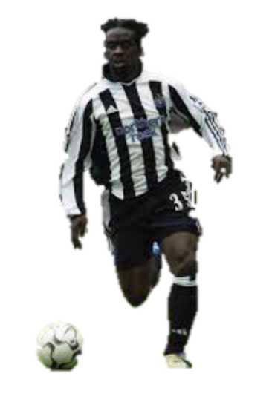
Olympique Lyonnais v. Olivier Bernard and Newcastle UFC Case C-325/08 (Judgement of 16 March 2010)
.
French Player of Olympique Lyonnais (French Club)
End of 3 years contract as a “talented young player”
Obligation to sign first Professional Contract with Training Club
Newcastle FC (English Club)
Compensation (damages) : 53.357, 16 euros (one year salary)
38

Slide 39
BERNARD CASE
A training Compensation can “be justified by the objective of encouraging the recruitment and training of young players”.
However, such a scheme must be actually capable of attaining that objective and
be proportionate to it,
taking due account of the costs borne by the clubs in training both future professional players and those who will never play professionally (para. 45).

Slide 40
This is only the beginning of a wonderful story
To be continued….

