Slide 1
THE INTERNATIONAL SKATING UNION CASE
By Michele Colucci

Slide 2
The ISU case
International Regulatory body for figure and speed skating at worldwide level
“Regulator” and “Sports event organizer”

Slide 3
Rules at stake
Pre-authorisation system for events of third-party organisers
THE ISU eligibility rules : Suspension - Lifetime ban for participating in unauthorized events by ISU

Slide 4
EU Commission’ investigation (2015- 2017)
Is ISU abusing its regulatory power by precluding
(i) Skaters from participating to such events?
(ii) Third parties from hosting different events

Slide 5
Analysis
ISU is a sports association but it is also an “undertaking”
Organization and commercial exploitation of sports events
A sport governing body cannot abuse its regulatory and disciplinary powers in an anti-competitive manner.

Slide 6
ISU justifications
Eligibility rules not linked to commercial considerations nor intended to stifle competitors, but rather
“protect” participants from illegal betting
Ensure integrity of sport
Protect the health of the athletes

Slide 7
ISU eligibility rules Legal analysis
Obstacles for skaters to their freedom to provide services
Significant barriers to finding skaters for third parties (events’ organisers)

Slide 8
Eligibility rules
Have the object but also the effect to restrict potential competition because:
(i) their purpose is to preclude other organizations from running competing events
(ii)ISU aims to protect its own economic interests
(iii) they are not related to a legitimate sporting objective as ISU claims

Slide 9
CAS as arbitration system
CAS as arbitration mechanism “reinforcing” the restriction of competition by object.

Slide 10
The General Court of the EU December 2020, Case T 93/18
ISU, as a sports federation, is subject to the obligations under Article 101 TFEU
must not distort competition between different sporting events by restricting the athletes' access to such events.
YES, eligibility rules had as their object the restriction of competition in the worldwide market for the organization and commercial exploitation of international speed skating events within the meaning of Article 101 TFEU.

Slide 11
Legitimate
Legitimate goals:
To ensure common standards for sporting events by means of a pre-authorization system.
To protect the integrity of sport from the risk of betting manipulation, for example.

Slide 12
The General Court of the EU
Fair and proportionate rules (and sanctions!!).
ISU severity of potential penalties: beyond what was necessary to achieve the objectives and, thus, were not proportionate.

Slide 13
Findings
ISU prone to a "conflict of interests" : regulator and organizer.
Powers of prior authorisation and sanctions are used in an arbitrary, discriminatory and disproportionate manner
Unlawful discretional power
ISU and (CAS) arbitration system do not reinforce the restriction of competition by object

Slide 14
ISU v. Commission C -124/21 Opinion of the AG of 15 December 2022
Sports Federations :
Specific characteristic of sport (See Art 165 TFUE) are relevant to justify restrictions on competitions
Dual Role (regulator and organizer): CoI…
BUT not necessarily violation of EU competition
They can deny access to third parties IF legitimate objectives and proportionate measures

Slide 15
ISU v. Commission C -124/21 Opinion of the AG of 15 December 2022
CAS: arbitration (exclusive and obligatory) clause for a body outside the EU
Quid EU uniformity and Judicial protection?
Arbitration between private parties and not between Member States
“Asymmetry of powers” (Federations/players)
BUT Justified by legitimate interests: “specialized judicial body”

Slide 16
Findings of the Court of Justice
Art.101 TFEU to sport as an economic activity
Specific caractheristics of Sport can be taken into account
MECA Medina Test does not apply to violations of competition by “object”(paras.111-113)
Art.101 (3): Giustifications apply (114)

Slide 17
ISU Dual Role
Framework of substantive, transparent, clear and precise criteria
No arbitrary use
Criteria promoting sporting competitions based on equality of opportunity and merity

Slide 18
ISU Dual Role
Non discriminatory criteria (identical and similar and not impossible or difficult to achieve by third parties because of their status)
Objective and proportionate sanctions
Effective Review
Transparent and non-discriminatory detailed procedural rules (para.135)

Slide 19
FINDINGS: UNLAWFUL DISCRETIONAL POWER
Powers used in an arbitrary, discriminatory and disproportionate manner
Rules not justified for the pursuit of the objectives
Lack of any transparent, objective, non discriminatory and reviewable criteria
Lack of objective and proportionate sanctions

Slide 20
Findings: the Prior Authorization System
Is able to allow or exclude from the market any (even equally efficient) undertaking
Deprive athletes from the opportunity to participate to those competitions
Deprive spectators and viewers to attend/to watch those competitions
THUS, IT RESTRICTS COMPETITION BY OBJECT

Slide 21
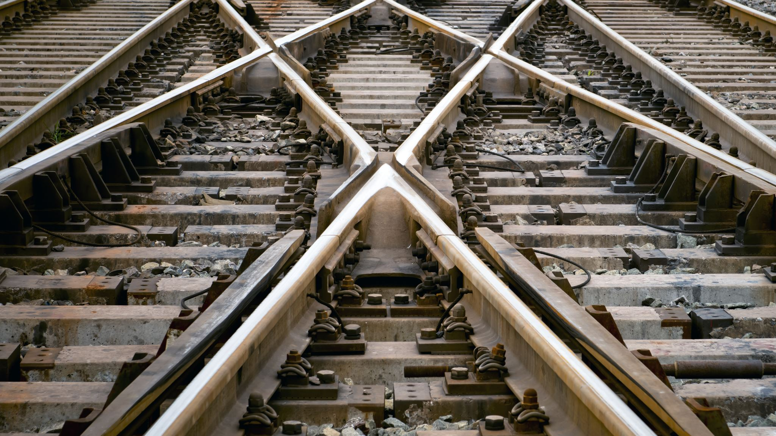
The Cross Appeal

Slide 22
The Court of Arbitration for Sport in the light of EU Competition Law

Slide 23
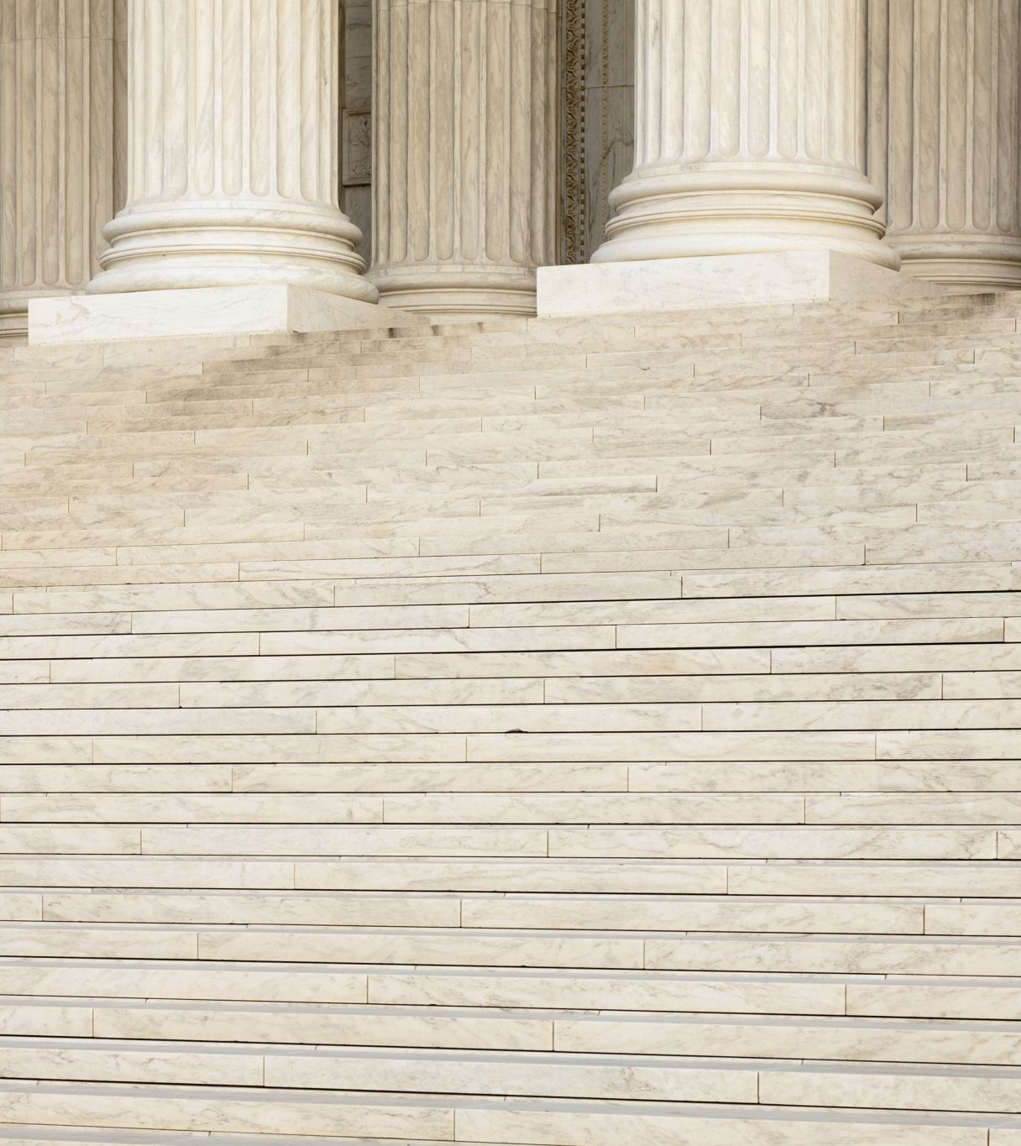
CAS
CAS Arbitration clause is not voluntarily accepted
CAS Arbitration clause is binding and gives exclusive jurisdiction
CAS is a “specialised court” but…

Slide 24
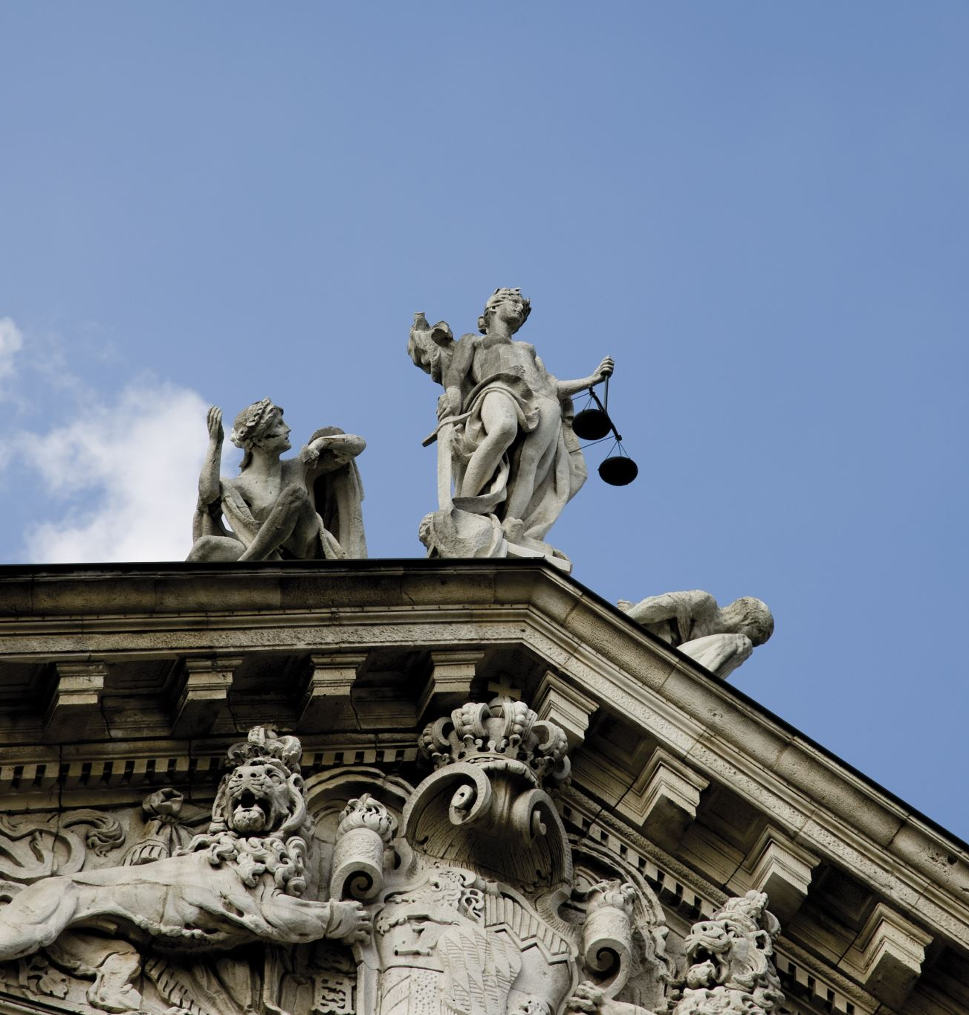
CAS
CAS is outside the European Union
CAS and Swiss Tribunal Tribunal (Court of a Third State)cannot and are not entitled to refer a matter to the EU Court of Justice
The European Commission and the NCA have discretion to deal with complaints
There is no effective judicial review under EU competition law
Seeking compensation for damages at level of the execution of an award does not

Slide 25
CAS
The European Commission and the NCA have discretion to deal with complaints
There is no effective judicial review under EU competition law

Slide 26
CAS
Compensation for damages suffered cannot compensate…compensation for the lack of remedy entitling someone to bring an action before a national court to:
Grant protective measures
Have the conduct brought to an end

