Slide 1
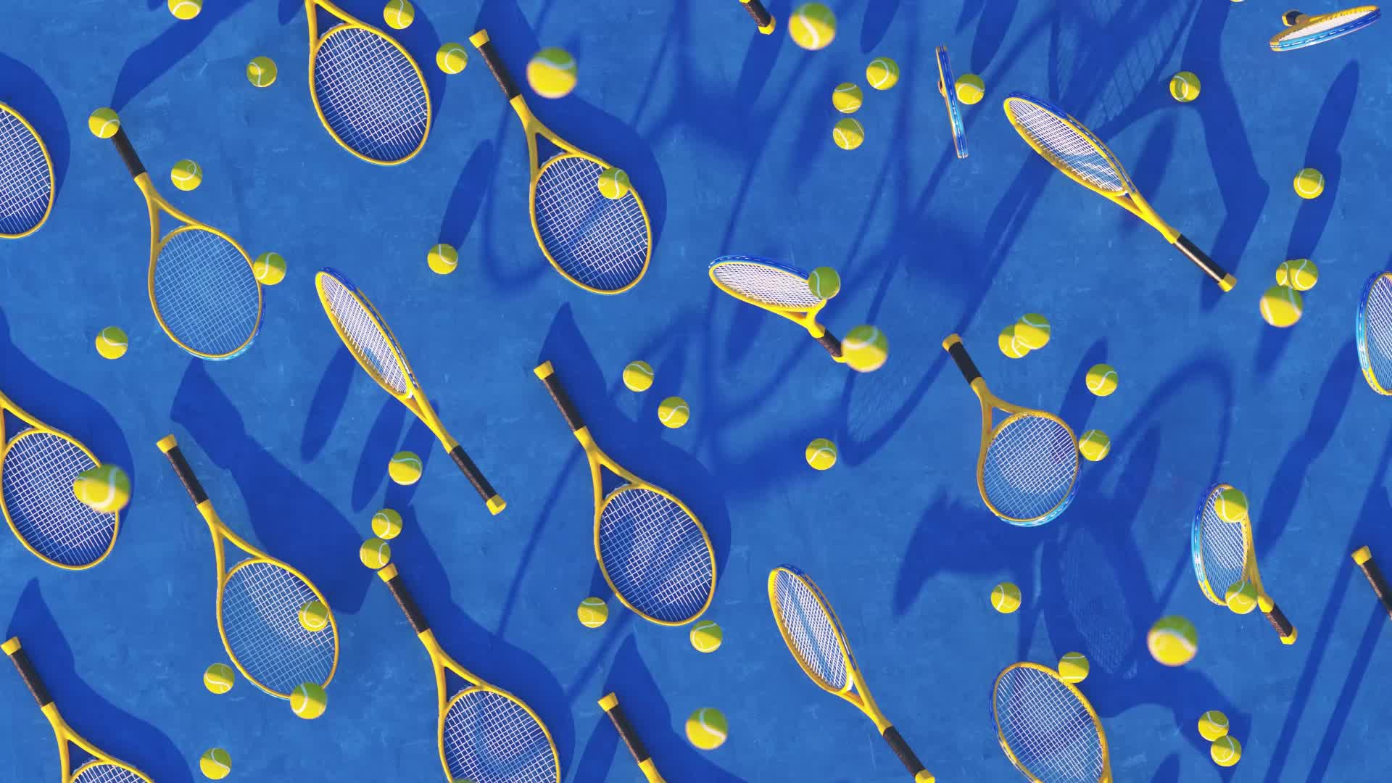
The Evolution of Sport at EU level In the name of Autonomy and Specificity of sport
MICHELE COLUCCI
www.colucci.eu
E-mail: info@colucci.eu

Slide 2
International sports cases before the EU judges D-DAY: 21 December 2023
Superleague against UEFA and FIFA
FC Antwerp against UEFA (homegrown player rule)
International Skating Union
Football Agents against FIFA (pending)
The Diarra case (pending)
The Seraing case (pending)

Slide 3
INTERNAL MARKET FREE MOVEMENT OF WORKERS
Art.45 TFEU :Workers have the right to:
accept offers of employment actually made;
move freely within the territory of Member States for this purpose;
to stay in a Member State for the purpose of employment;
to remain in the territory of a Member State after having been employed in that State.
Art. 56 TFEU :Self-employed/professionals are free to provide their services

Slide 4
EQUAL TREATMENT
BAN ON “DIRECT” DISCRIMINATIONS
Art. 18 TFEU on the basis of nationality
Art. 45 TFEU:…
Access to employment
Pay
Employment conditions
BAN ON “INDIRECT” DISCRIMINATIONS (UEFA Home Grown Player Rule ?)
NO INDIRECT DISCRIMINATION : based on criteria other than nationality but leading to the same result

Slide 5
SPORT AND EU COMPETITION LAW : Art. 101 (1)
Are prohibited and automatically void :
Decisions, Agreements, Concerted Practices
Undertakings or associations of undertaking
Affecting trade between Member States
By Object or by Effect
Prevention, Restriction or Distortion of Competition

Slide 6
SPORT AND EU COMPETITION LAW: Art. 101 (3) The four cumulative exceptions
The Agreement results in efficiency gains
Consumers receive a fair share of the benefits
The restrictions are indispensable of achieving those benefits
There is no substantial elimination of competition

Slide 7
SPORT AND EU COMPETITION LAW: Art.102 (TFEU)
No to any abuse of dominant position by one or more undertakings

Slide 8
Bosman v. URSBFA - UEFA - FIFA DAVID v. GOLIATH

Slide 9
UEFA –URSBFA v. Bosman C-415/93 (Judgement of 15 December 1995)
Belgian Player of RC Liège (Belgian Club)
Salary (120.000 BEF = 3000 euros)
End of contract =750 euros
Transfer fee…
FC Dunkerque (French Club)

Slide 10
Transfer Fee (11.570.000 BEF = 200.000 euros)
WHY 200.000 euros ?
How was it calculated?

Slide 11
TRANSFER FEE
Obstacle because it affects players'access to the employment market in other Member States
NO valid justifications: maintenance of sportive and competitive balance between clubs
Other alternative measures: marketing, ticketing, TV rights
Conclusions: Transfer fee after the end of the contract against EU law

Slide 12
Quota System
Quota system on Foreign players to be fielded restricts the opportunities to be employed
No valid justifications
Irrelevant territorial link
Train national players in view of the National Team
Maintaining a competitive balance between clubs, since there are no rules limiting the possibility for richer clubs to recruit the best national players.

Slide 13
FIFA RSTP
«Gentlemen’s Agreement » (2001)
Main Principles :
Contractual stability (protected period)
Training compensation
Solidarity mechanism
Protection of Minors
Dispute Resolution System
Freedom to submit disputes to Ordinary Courts

Slide 14
Basic Principles of Union Law
EU law applies to Sport in so far it constitutes an economic activity (ECJ case law)
No Activities “purely” social, artistic or sporting ......
but then “MECA MEDICA” judgement of 18 July 2006...
Test of “Necessity”
Test of “Proportionality”

Slide 15
MECA MEDINA – MADJEN Case C-519/04 P (18 July 2006)

Slide 16
DOPING: Two swimmers tested positive
Sports track
FINA Sanction (4 years Ban)
CAS sanction ( 2 years Ban)
Ordinary EU Track
EU Commission (no competent)
General Court (no competent)
Court of Justice (competent)

Slide 17
PRINCIPLES
No assessment in abstract
Account must be taken of a:
“the overall context” in which the decision of the association of undertakings was taken or produces its effects.
Its objectives: measures inherent in the pursuit of those objectives and proportionate to them.
Proportionality of measures (quid sportive sanctions?)

Slide 18
FINDING OF THE COURT
IOC = association of undertakings (NOCS)
OVERALL CONTEXT : Doping rules have a legitimate objective (fight against doping – fair play – protection of the athletes’ health)
NEVERTHELESS sanctions must be proportionate to the (sports) offence committed

Slide 19
Specificity of Sport
NO BLANKET EXEMPTION from EU competition law
All rules on authorizations of third-party events must be based on objective, transparent,non discriminatory criteria
Sanctions must be proportionate (MECA –Medina test).

Slide 20
The White Paper on Sport (2007)
4.1. SPECIFICITY OF SPORT
Sport activity is subject to the application of EU law.
At the same time, sport has certain specific characteristics, which are often referred to as the "specificity of sport"

Slide 21
The White Paper on Sport (2007)
4.1. Organizazion of Sport
The political debate on sport in Europe often attributes considerable importance to the so-called "European Sport Model".
The Commission considers that certain values and traditions of European sport should be promoted. In view of the diversity and complexities of European sport structures it considers, however, that it is unrealistic to try to define a unified model of organisation of sport in Europe.
Moreover, economic and social developments that are common to the majority of the Member States (increasing commercialisation, challenges to public spending, increasing numbers of participants and stagnation in the number of voluntary workers) have resulted in new challenges for the organisation of sport in Europe.

Slide 22
ART. 6 TFEU (2007) entry into force (2009)
The Union shall have competence to carry out actions to support, coordinate or supplement the actions of the Member States. The areas of such action shall, at European level, be:
(e) education, vocational training, youth and sport.

Slide 23
ART. 165 TFEU (2007)entry into force (2009)
“The Union shall contribute to the promotion of European sporting issues while taking account of its specific nature, its structures based on voluntary activity and its social and educational function”. (art. 165 TFEU, para. 1)
Union Action shall be aimed at : …
developing the European dimension in sport,
by promoting fairness and openness in sporting competitions and cooperation between bodies responsible for sports, and by
protecting the physical and moral integrity of sportsmen and sportswomen, especially the youngest sportsmen and sportswomen. (art. 165 TFEU, para. 2)
(Some ideas: the “Erasmus Sports Programme” )
https://www.youtube.com/watch?v=AJ_cujtx1Dw
European Parliament : 10 October 2010

Slide 24
THE INTERNATIONAL SKATING UNION CASE

Slide 25
The ISU case
International Regulatory body for figure and speed skating at worldwide level
“Regulator” and “Sports event organizer”

Slide 26
Rules at stake
Pre-authorisation system for events of third-party organisers
THE ISU eligibility rules : Suspension - Lifetime ban for participating in unauthorized events by ISU

Slide 27
ISU Dual Role= conflict of interest
Framework of substantive, transparent, clear and precise criteria
No arbitrary use
Criteria promoting sporting competitions based on equality of opportunity and merit

Slide 28
Findings: the Prior Authorization System
Is able to exclude from the market any (even equally efficient) undertaking
Deprive athletes from the opportunity to participate to those competitions
Deprive spectators and viewers to attend/to watch those competitions
THUS, IT RESTRICTS COMPETITION BY OBJECT

Slide 29
AS FOR THE CAS
CAS Arbitration clause is not voluntarily accepted
CAS Arbitration clause is binding and gives exclusive jurisdiction
CAS is a “specialised court” but…

Slide 30
CAS
CAS is outside the European Union
CAS and Swiss Tribunal Tribunal (Court of a Third State)cannot and are not entitled to refer a matter to the EU Court of Justice
The European Commission and the NCA have discretion to deal with complaints
There is no effective judicial review under EU competition law
compensation for damages at level of the execution of an award is not enough

Slide 31
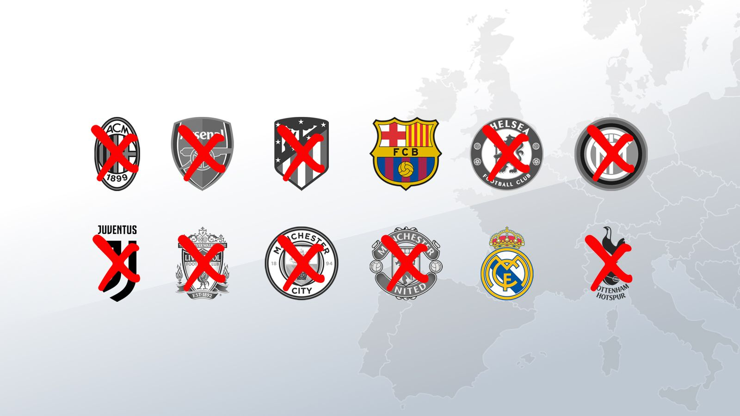
THE SUPERLEAGUE CASE ESLC v.FIFA and UEFA (A22 Sports Management – RFEF-LNFP) by Michele Colucci

Slide 32
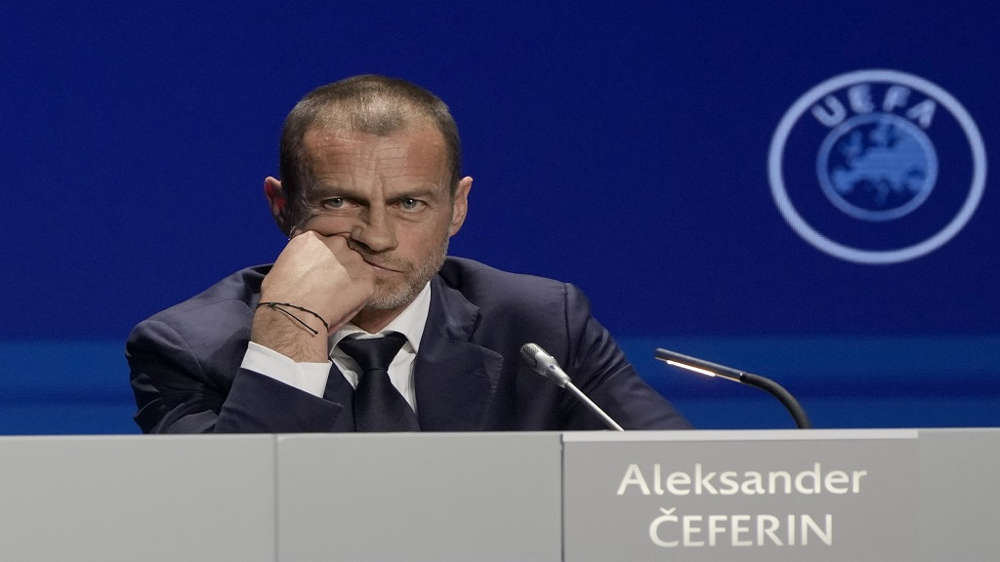
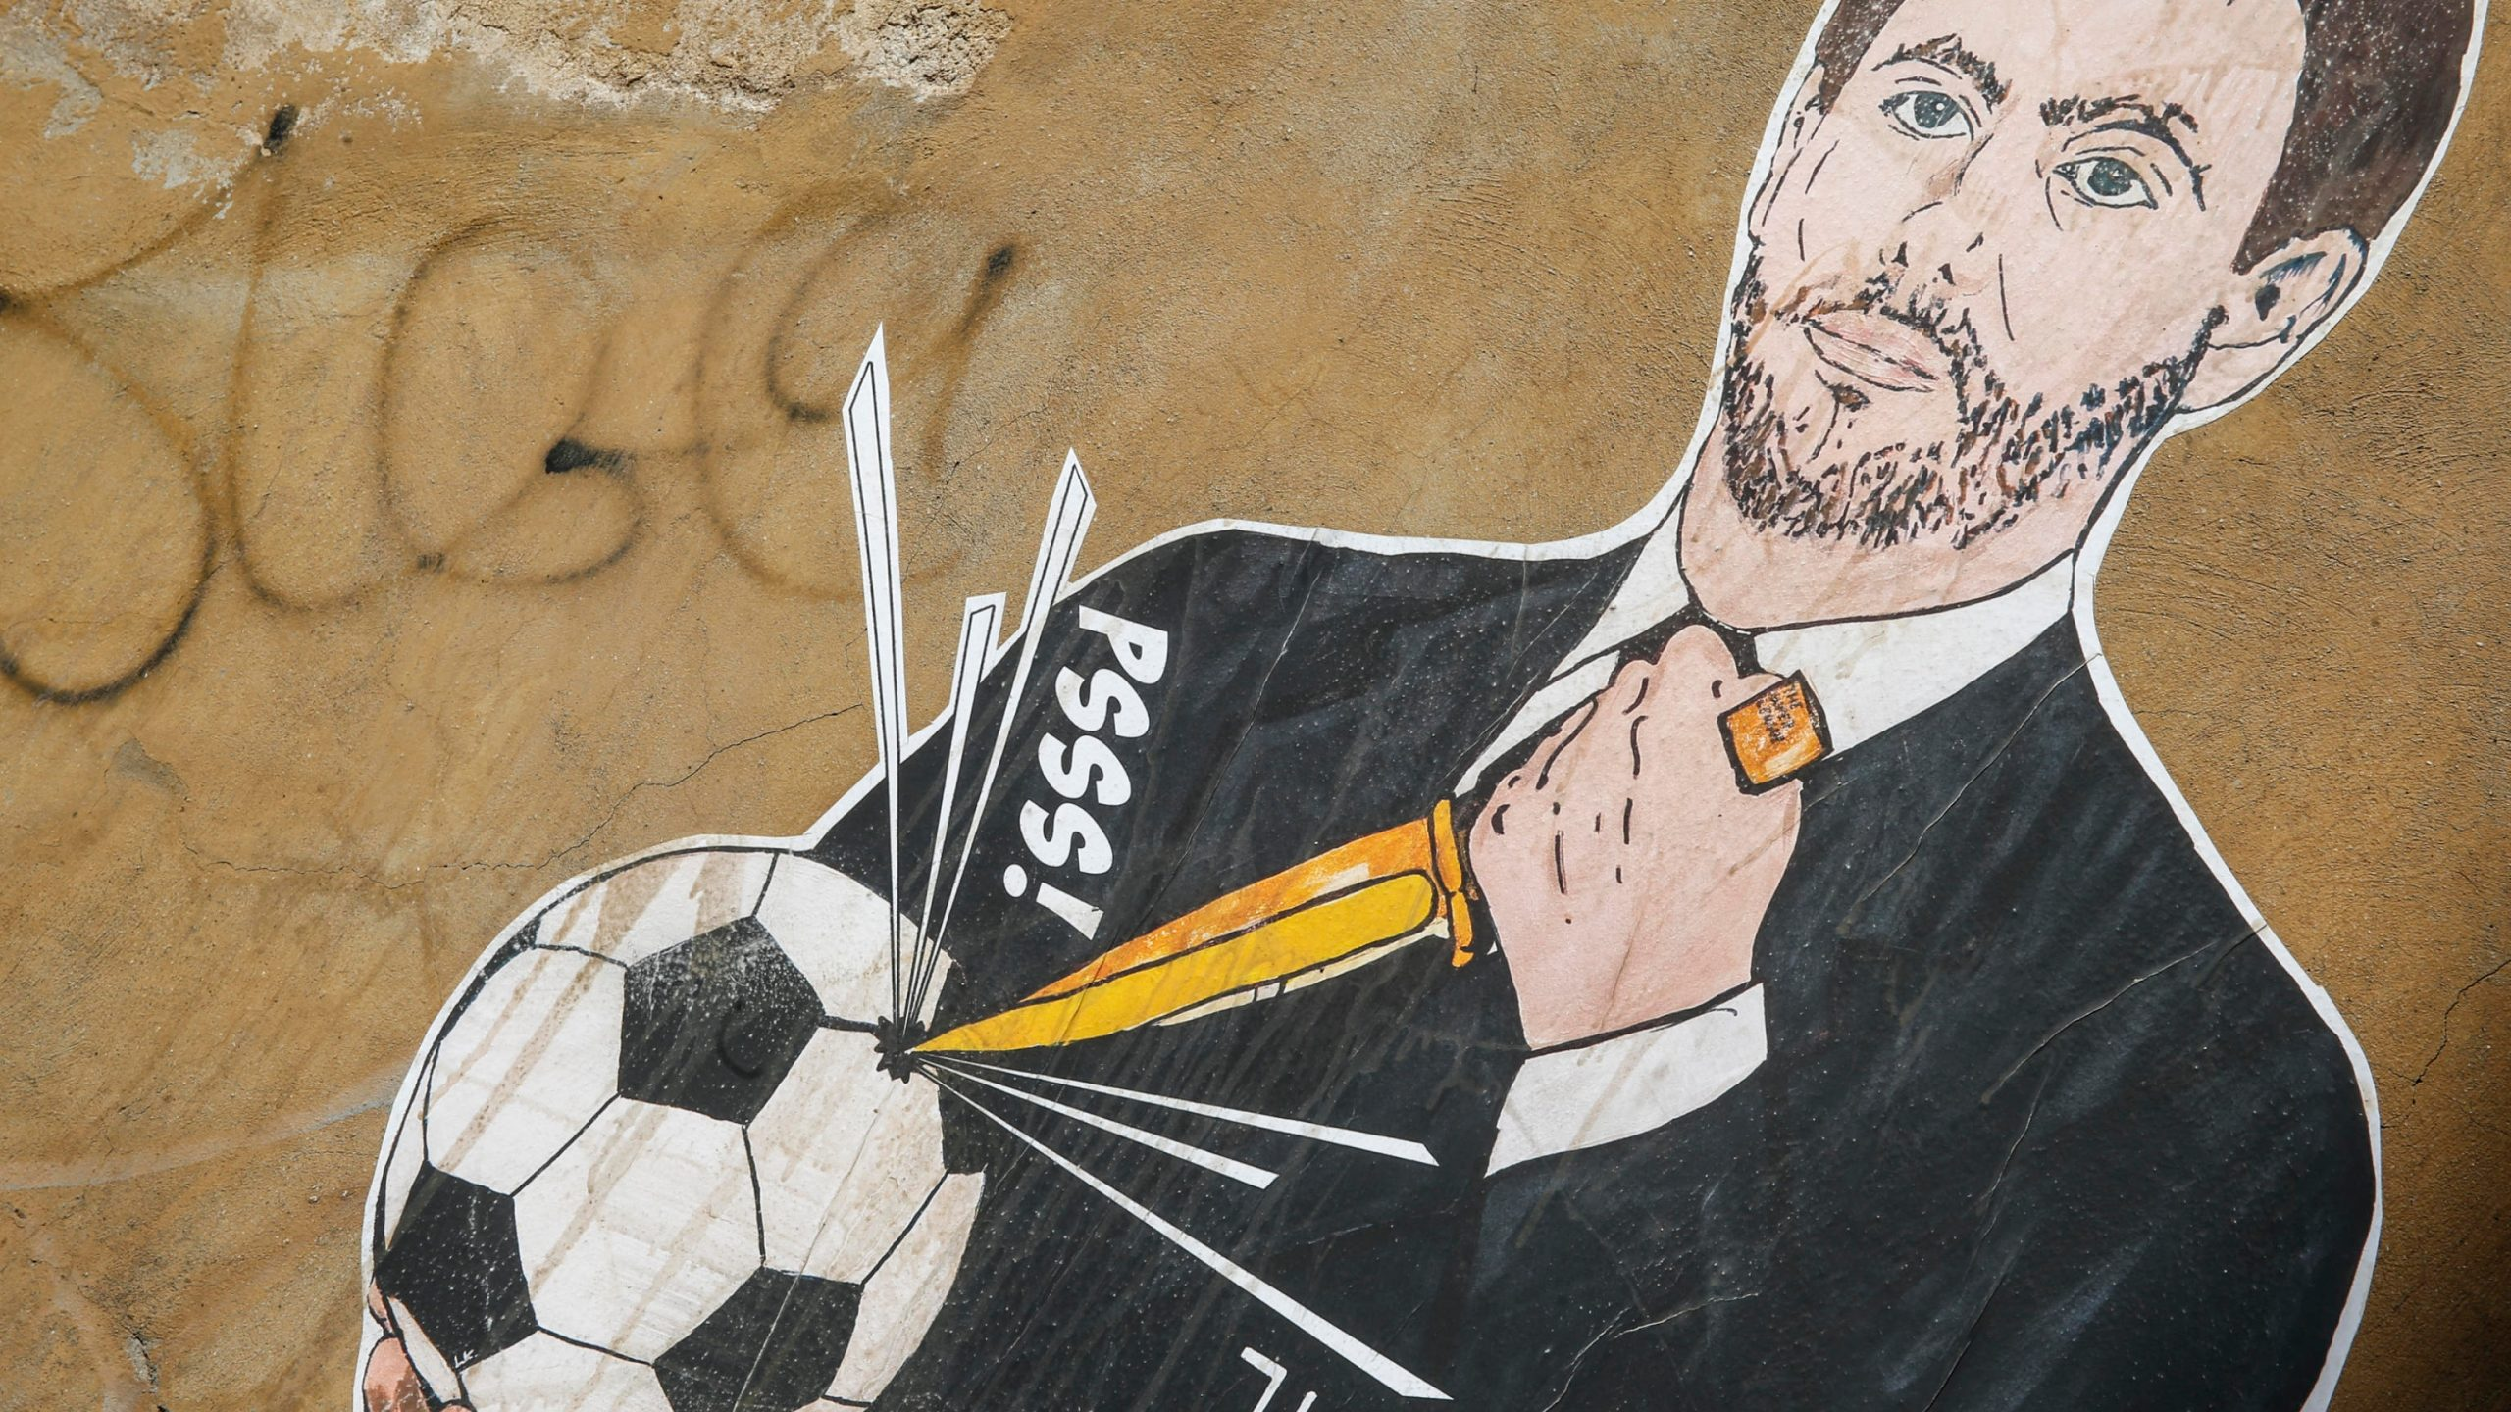
21 January 2021

Slide 33
The Super League Project
European Superleague Company SL
Nature: Private Company under Spanish Law (12 clubs)
Goal: new International interclub competitions
Means:
3 companies for:
Management of the competition
Exploitation of media rights
Exploitation of other commercial rights
JP Morgan : financial support (4 billion EUR)

Slide 34
Three Rules at stake
FIFA-UEFA “prior approval” rules of any international football competitions
Clauses obliging Clubs and Players to participate only to their competitions, on pain of exclusion.
Provisions for FIFA and UEFA as “original owners” of all sporting rights (“exclusive exploitation”)

Slide 35
Six Preliminary Questions on FIFA and UEFA Rules
Prior Authorization: Art.102 TFEU on abuse dominant position
Prior authorization: Art. 101 TFEU on free competition
Threat of sanctions: Artt. 101 and 102 TFEU
“Original Owners of rights”: Artt. 101 and 102 TFEU
Prior Authorization “exception” : Art.101 (3) and 102 TFEU
Prior Authorization: Artt. 45-49 -56 and 63 TFEU (freedom of movement)

Slide 36
Art. 165 TFUE
EU: support coordination and supplement to Member States in Sport
Promotion of European Dimension of Sport
Foster co-operation with third countries
It allows to pursue an Action and not a Policy on Sport (para. 99)
It is not a cross-cutting provision having a general application (para.100)
Specific nature but not exception for Sport n the application of the Treaty (para.104)
Specific assessment (Sports are not all the same: different level of professionalism)

Slide 37
Art. 165 TFUE In the eyes of two Advocate Generals
Superleague case
Social Provision
Horizontal provision for all EU policies
Constitutionalisation of “sports law”…
Thus derogation to other EU principles
HGP case
Addressed to EU and not to MS and private Associations
Wording of soft law
Professional and recreational sports
Clubs and individuals
“false legal basis”

Slide 38
Is Prior Approval in line with Art. 102 TFEU?
UEFA – FIFA dominant position
“Special responsibility” :
Prevent undistorted competition
Not unduly deny access to the market ( para.131)

Slide 39
UEFA AND ITS DUAL ROLE:
REGULATORY
ECONOMIC

Slide 40
POWER TO:
AUTHORISE AND SETTING UP A NEW COMPETITION
CONTROL THE PARTICIPATION OF FOOTBALL CLUBS AND PLAYERS
SANCTIONS

Slide 41
CONFLICT OF INTEREST BUT IT IS LEGITIMATE TO HAVE:
Common rules for homogeneity and coordination of competitions, equal opportunities and merits (para.144)
Prior authorization system (para.145)
Sanctions (para.146)
BUT…

Slide 42
Compliance with Art. 102 TFEU FEDERATIONS NEED TO HAVE (paras 147-148):
SUBSTANTIVE CRITERIA and DETAILED PROCEDURAL RULES:
TRANSPARENCY
OBJECTIVITY (no discretion)
PRECISION
NON DISCRIMINATION

Slide 43
Compliance with Art. 102 TFEU
Proportionality of sanctions (para.148)
Accessibility of Rules prior to their implementation (para.151)
Irrelevant that new competitions are not subject to FIFA and UEFA rules because of their control on national football associations, clubs and players

Slide 44
Compliance with Art. 102 TFEU CONCLUSIONS
UEFA and FIFA prior approval system is an abuse of dominant position!

Slide 45
Art. 101 TFEU
FIFA and UEFA Prior Authorization =
Obligation for players and clubs to participate to their competitions +
Prohibition to participate in “third competitions”
Sanctions

Slide 46
Art. 101 TFEU
Agreement having an anticompetitive object? namely:
Collusive conduct leading to price fixing
Limitation on production capacity
Horizontal agreements leading to exclusion of competitive undertakings (para.164)

Slide 47
UEFA and FIFA :“Dual Role”
Undertaking and Association of Undertaking
Regulatory role: adopting rules for professional football
Economic role: organizing sporting competitions
Giving the power to:
Authorise the setting up and organization of new competition
Control the participation of professional football clubs and players, on pain of sanction (171)

Slide 48
LEGITIMATE OBJECTIVES
Observance of:
Principles
Values, and
Rules of the game (para.176)

Slide 49
BUT…NO:
SUBSTANTIVE CRITERIA
DETAILED PROCEDURAL RULES
TRANSPARENCY, OBJECTIVITY, NON- DISCRIMINATION (para.175)

Slide 50
Consequences
FIFA and UEFA RULES:
“if not exclude” competitors from the market, they restrict the creation of alternative and “innovative” formats
Spectators cannot attend those competitions (para.176)
Reinforce the barrier to entry in the market (para.177) because third entities clubs and players (vulnerable for sanctions)

Slide 51
CONCLUSIONS:
FIFA AND UEFA RULES CONTRARY TO ART.101 TFEU

Slide 52
ARE SANCTIONS against Art. 101 and 102 TFEU?
OF COURSE THEY ARE!
THEY AIM TO IMPLEMENT AN ILLEGAL REGIME (para.180)

Slide 53
Exemptions? Artt. 101 (3) and 102 TFEU
FOUR cumulative conditions:
1. The agreement result in efficiency gains
2. Consumers receive a fair share of the benefits
3.Restrictions are necessary to achieving those benefits
4.There is no substantial elimination of competition

Slide 54
Exemptions
BURDEN OF PROOF ON FIFA AND UEFA
NATIONAL JUDGE will decide if favourable impact on ”users”:
National football associations
Professional or amateur clubs
Professional or amateur players
Young players
Spectators and TV viewers
BUT also ”solidarity contribution”

Slide 55
HINT (para. 99):
No substantive criteria and no detailed procedural rules
No transparency, clarity neutrality, precision and proportionality…
Prevention of any and all competition on the market

Slide 56
Exploitation of all rights relating to sports competitions Artt. 101 and 102 TFEU
FIFA and UEFA “original owners”
FIFA : exclusive power on exploitation and use of those rights

Slide 57
CONSEQUENCES
No access to clubs in the marketing of those rights
No access to third undertakings
Detrimental for consumers and TV users
Standardization of Buyers’ conduct
Less choice and less innovation

Slide 58
THUS:
RESTRICTION OF COMPETITION AND ABUSE OF DOMINANT POSITION

Slide 59
Exploitation of rights relating to sporting competitions Artt. 101 and 102 TFEU : JUSTIFICATIONS
GENUINE FINANCIAL SOLIDARITY (para.235)
BETTER PRODUCTION AND REDISTRIBUTION RIGHT
CONCRETE EVIDENCE FOR THE NATIONAL JUDGE (para.236)

Slide 60
Compatibility with EU Freedom to provide services :
Art. 56 TFEU: NO to rules prohibiting, impeding or rendering less attractive the activity of service providers
PRIOR Authorization as obstacle to Freedom to provide services for third organisers and clubs
Obstacle to freedom of movement

Slide 61
UL and Royal Antwerp FC v. URSBFA and UEFA
THE HOME – GROWN PLAYERS’ RULE
Michele Colucci

Slide 62
INTERNAL MARKET FREE MOVEMENT OF WORKERS
Art.45 TFEU :Workers have the right to:
accept offers of employment actually made;
move freely within the territory of Member States for this purpose;
to stay in a Member State for the purpose of employment;
to remain in the territory of a Member State after having been employed in that State.
Art. 56 TFEU :Self-employed/professionals are free to provide their services

Slide 63
EQUAL TREATMENT
BAN ON “DIRECT” DISCRIMINATIONS
Art. 18 TFEU on the basis of nationality
Art. 45 TFEU:…
Access to employment
Pay
Employment conditions
BAN ON “INDIRECT” DISCRIMINATIONS (UEFA Home Grown Player Rule ?)
Association agreement, Co-operation agreement,
SPORT: Balog case, Simutenkov case

Slide 64
« COVERT DISCRIMINATIONS »
NO « COVERT FORMS OF DISCRIMINATION” which, by the application of other criteria of differentiation, lead in fact to the same result . (cause 152/73 Sotgiu)

Slide 65
THE UEFA HOMEGROWN PLAYER RULE
HOMEGROWN PLAYERS:
Regardless their nationality have been trained by their club or by another club of the same national football association
Trained by a club for 3 years when he is between 15 and 21 years old
2006/2007 4 out of 25 on the match sheet
2007/2008 6 out of 25 on the match sheet
2008/2009 8 out of 25 on the match sheet
ACCEPTED UNTIL NOW BUT…
FC ANTWERP AGAINT UEFA

Slide 66
URBSFA (Belgium)
“Squad Size Limit list”:
8 trained by a Belgian club before their 23rd birthday
3 of them trained by their own club for at least 3 full seasons before their 21st birthday
“Match Sheet”:
6 trained by a Belgian club before their 23rd birthday
2 of them trained by their own club for at least 3 full seasons before their 21st birthday
If not,sanctions for the inclusion of ineligible players, with the exception of fines

Slide 67
Claims
Restriction of competition ex Art. 101 TFEU
Obstacle to freedom of movement ex Art. 45 TFEU:
Clubs limited in recruiting players who do not meet HGP requirements
Non HGP Players limited in be recruited and fielded

Slide 68
Art. 165 : Specific Caractheristics of Sport
Promotion of European Sporting issues
Development of the European dimension of sport by promoting fairness and openness in sporting competitions, physical and moral integrity
The UNION is competent to carry out “actions” to SUPPORT, COORDINATE and SUPPLEMENT actions of Member States in Sport (Art. 6 (e) TFEU)

Slide 69
Art. 165 : Specific Caractheristics of Sport
Art 165 is not a cross-cutting provision having general application
It enables to pursue not a “policy” but rather “actions” in sport
IT IS NOT AN EXCEPTION TO EU LAW!! (para 69)
Specific characteristics may be taken into account along with other elements provided that they are relevant with Artt. 45 and 101 TFEU
Assessment on a case by case basis:
nature, organisation, functioning, level of professionalism of sport concerned (para 73)

Slide 70
The Legal Analysis: Art. 101 TFEU
HGP Rule: limitation at level of the national association
HGP Rule: also limitation at club level
Sports associations can legitimately regulate conditions for clubs to participate to sports competition (104)
Sport has considerable social and sports importance but also generates great media interest
Participation is based on sports merits

Slide 71
The Legal Analysis: Art. 101 TFEU
Participation is based on sports merits.THUS need to have:
Homogeneous regulatory and technical conditions
Equal opportunity

Slide 72
The Legal Analysis: Art. 101 TFEU
HGP Rules limit or control an essential parameter of the competition:
“The recruitment of talented players, whatever the club or place where they were trained,which could enable their team to win in the encoutner with the opposing team” (para 107)

Slide 73
The Legal Analysis: Art. 101 TFEU
HGP Rules have an impact on the competition:
“The recruitment of talented players, whatever the club or place where they were trained,which could enable their team to win in the encoutner with the opposing team” (para 107)
Upstream or supply market”: recruitment of players
“Downstream market”: interclub football competitions.

Slide 74
The Legal Analysis: Art. 101 TFEU
National judge will decide if the rules present a degree of harm for clubs and players (anticompetitive restriction by object),
Restriction to ”resources” : players from other football associations
The proportion of players concerned is relevant (para. 109)
“National Prerence or not” (para.110)

Slide 75
Anticompetitive restriction by effect:
MECA MEDINA TEST:
Legitimate objectives
Necessary means
Inherent effects (proportionality)

Slide 76
Exemptions? Artt. 101 (3) and 102 TFEU
FOUR cumulative conditions:
1. The agreement result in efficiency gains
2. Consumers receive a fair share of the benefits
3.Restrictions are necessary to achieving those benefits
4.There is no substantial elimination of competition

Slide 77
Legal Analysis under Art. 101 (3), first condition
The rules may encourage professional football clubs to recruit and train your players and therefore intensify competition through training.
The national judge has to determine (economic, statistical or other nature analysis) (para. 129)
Efficiency gains ? Yes or not?
IF yes, are they likely to compensate for disadvantages resulting from those rules for competition? (para.129)

Slide 78
Legal Analysis under Art. 101 (3), second condition
Favourable benefits for users
Football Clubs
Players
Spectators
Good maybe for some clubs but detrimental for others

Slide 79
Legal Analysis under Art. 101 (3), third condition
Strict necessity of the HGP rule
ALTERNATIVE MEASURES (training compensation and financial mechanisms in particular for smaller clubs)

Slide 80
Legal Analysis under Art. 101 (3), fourth condition
Non elimination of competition:
Importance of the minimum proportion of home-grown players

Slide 81
Analysis ex art. 45 TFEU
Indirect discrimination
Players who do not have a “national connection” cannot be included on the match sheet and, therefore cannot be fielded (para. 138)
Thus prohibited!

Slide 82
Legal Analysis ex art. 45 TFEU: Justification
Legitimate objective: foster training of young players
Proportionality of the measure:what is the incentive to train player locally if clubs can still buy players from other clubs in the national association? NONE!

Slide 83
What’s next?
- ALL SPORTS (INTERNATIONAL AND NATIONAL° FEDERATIONS NEED TO COMPLY
- CONTROL BY THE EUROPEAN COMMISSION
83

