Slide 1
HOW Will FOOTBALL SURVIVE THE CORONAVIRUS?
By Michele Colucci www.colucci.eu info@colucci.eu
Sports Law and Policy Centre | LawInSport Survey (v3.0, 5 June 2020)

Slide 2

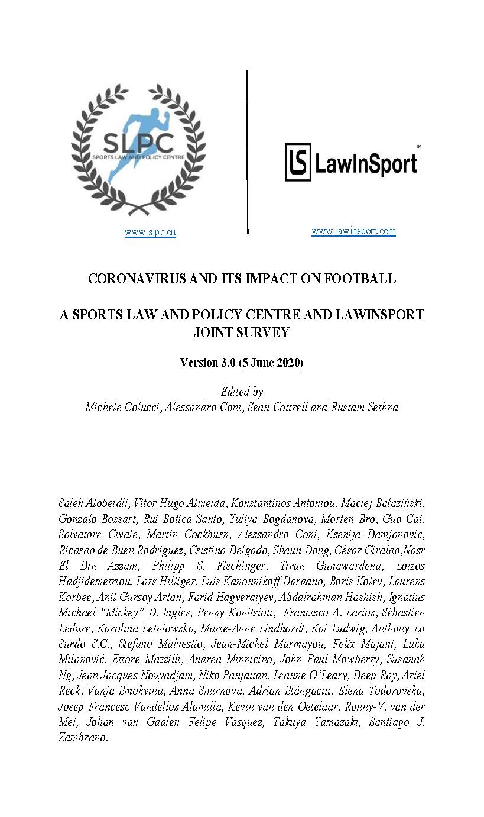

Slide 3
STATUS OF CHAMPIONSHIPS IN 52 Countries WorLDWIDE

Slide 4
52 countries, Representing all 6 FIFA CONFEDERATIONS
The “Big Five” Leagues (England, France, Germany, Italy, and Spain)
20 Other European federations (Azerbaijan, Belgium, Bulgaria, Croatia, Cyprus, Denmark, Greece, The Netherlands, Norway, Poland, Portugal, Romania, Russia, Scotland, Serbia, Slovenia, Sweden, Switzerland, Turkey and Ukraine)
10 from the Americas (Argentina, Brazil, Canada, Chile, Colombia, Ecuador, Mexico, Paraguay, Uruguay and USA)
6 from Africa (Cameroon, Egypt, Ghana, Kenya, Nigeria and South Africa)
11 from Asia and Oceania (Australia, China, India, Indonesia, Japan, Malaysia, New Zealand, Philippines, Qatar, Saudi Arabia and UAE)

Slide 5
Central Themes
Status of Leagues
Government Measures
Employment Status of Players
Federation Measures
League Measures
Broadcasting & Sponsorship
Player Associations/CBAs
Insolvency
Dispute Resolution
Return to Play

Slide 6

Top FIVE LEAGUES
Championships: FRA (cancelled), GER (first to be resumed), ES, IT, EN (resumed in June)
Governments’ Measures : ENG, FRA, GER, IT, ES, (unemployment schemes)
Federations: ENG (EFL: relief fund), GER, IT (special line credits) and, finally… Special fund “save football” (4.6.20)
TV revenues: FRA “payment plan” for games already played, ENG, deferral payment ( PL and Sky).
PLAYER ASSOCIATIONS: ENG: “hardship loan” to players in need.
Player-club negotiations: reduction of salary Atletic Bilbao (Spain), Juventus and Rome (Italy), Arsenal and Aston Villa (England), Borussia Dortmund (Germany)
N.B. Germany: 4 UEFA CH. Leagues: 20 mil. Euros to clubs lower down the pyramid

Slide 7
Other 47 Leagues the STATE OF PLAY
All championships suspended except
ARG – BE- CAM- CYP- KEN- MEX- NL- SCO (CANCELLED)
Governments : AUS, BEL, BRA, DK, MAL, NL, PAR, PT, RO,SA, URU
General unemployment benefits
Federations: JAP, NL, PT: emergency funds
Player-club negotiations:reduction from 10%to 50 % or deferred payment
N.B. Sapporo players (Japan):
voluntary restitution to their club

Slide 8
BROADCASTING:
Regular payment in Poland, Russia, Serbia, Slovenia, Switzerland, Argentina, Ecuador, China, Qatar
On- going negotiations between leagues and broadcasters (Croatia, Cyprus Denmark, Turkey, Colombia, Uruguay, Ghana, Saudi Arabia, U.A.E.).
Deal reached (Scotland).
SPONSORSHIP:
In some countries (Croatia, Cyprus, Slovenia, Colombia, Ecuador, Ghana) sponsors have already asked for a rebate and/or halted their payments.

Slide 9
INSOLVENCY PROCEEDINGS STRICTLY RELATED TO THE PANDEMIC
NONE, but…clubs in serious economic difficulties
Clubs already with financial problems (among others 11 clubs China, 8 in Colombia, Malaga CF in Spain)

Slide 10
The Legal Effects of Coronavirus on FOOTBALL EMPLOYMENT AGREEMENTS
FIFA GUIDELINES (APRIL 2020): NO DEFINITION OF A FORCE MAJEURE SITUATION
RELEVANT LEGAL SYSTEM ( CIVIl LAW COUNTRIES and COMMON LAW COUNTRIES (Frustration))
FIFA IS NOT PART OF THE EMPLOYMENT AGREEMENTS!

Slide 11
AGREEMENTS AT STAKE and GUIDING PRINCIPLES
Expiring agreements : extension until the new end
New agreements already signed : commencement on the new date
N.B. Overlapping seasons and/or registration periods: unless the parties agree otherwise, priority to the former club
Agreements that cannot be performed as the parties originally wanted:

Slide 12
AGREEMENTS AT STAKE AND GUIDING PRINCIPLES
Agreements that cannot be performed as the parties originally wanted:
- National employment and/or insolvency law or CBA
- Principle of Equal Treament
- Good faith
Proportionality and reasonability test
Alternatevely, “suspension” of the agreements but:
  1.Proper insurance
  2.Adequate alternative incomes

Slide 13
IMPACT ON DECISION MAKING
UNILATERAL VARIATIONS Vs. UNILATERAL TERMINATION
WHAT IS ALLOWED ? WHAT NOT?
FORCE MAJEURE AND CLAUSULA REBUS SIC STANTIBUS

Slide 14
IMPACT ON DECISION MAKING
EXPIRING AGREEMENTS AND NEW AGREEMENTS
(so far no disputes concerning refusals to exted or delay and agreement)
1.Assessment of the relevant law or CBA
2. Contractual autonomy of the parties

Slide 15
IMPACT ON DECISION MAKING
AGREEMENTS THAT CANNOT BE PERFORMED AS THE PARTIES ORIGINALLY ANTICIPATED
UNILATERAL VARIATIONS: Are they valid?
Assessment of the relevant law or CBA
Contractual autonomy of the parties

Slide 16
UNILATERAL VARIATIONS
EQUAL TREATMENT: no discriminatory measures against targeted employees (eg. Higher paid employees, foreigners, older employees) : INVALIDITY OF MEASURES
CHOICE OF LAW and/or CBA: (BURDEN OF PROOF, how?)
GOOD FAITH: what elements to produce? Relevant correspondence, minutes of meetings,…
REASONABLENESS AND PROPORTIONALITY TESTS:
- attempt to reach a mutual agreement
- economic situation of the club
- proportionality of the amendments
-Net income of the player after amendments
- Individual or collective measure

Slide 17
LESSONS TO BE LEARNED
DIFFERENT APPROACH TO COMMERCIAL AND EMPLOYMENT CONTRACTS
SETTING UP SPECIFIC RESERVE FUNDS
REVISING THE FUNDING OF GRASS- ROOTS AND LOWER LEVEL FOOTBALL
REFORMING THE ACCOUNTING RULES AND PROCEDURES OF ALL CLUBS
Rethinking Football

