Slide 1
FIFA REGULATIONS FOR THE STATUS AND TRANSFER OF PLAYERS (RSTP) :
THE WAY AHEAD
Michele Colucci
Member of the Dispute Resolution Chamber FIFA FOOTBALL TRIBUNAL
info@colucci.eu - www.colucci.eu
Football Academy
Università degli Studi Di Bologna

Slide 2
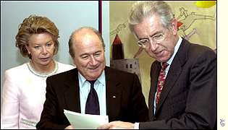
GENESIS
The Bosman case (15 December 1995)
The Gentlemen’s agreement FIFA UEFA European Commission(2001)
  The five principles:
    Freedom of movement
    Protection of minors
    Training compensation
    Solidarity mechanism
    Dispute resolution and
    arbitration system
From 2001 to 2023 FIFA Regulations: from monologue to dialogue with stakeholders

Slide 3
FIF A RSTP: SCOPE
  Global binding rules concerning the Status of Players
  Eligibility to participate in “Organised Football”
  Transfers between clubs belonging to different Associations
  Release for National Association Teams

Slide 4
‘
‘
FIFA FOOTBALL TRIBUNAL
Dispute Resolution Chamber
Players’ Status Chamber
Agents Chamber

Slide 5
Composition and Procedural Rules
DRC :15 P. +15 C.
PSC and AC: “necessary number” appointed by Sports Stakeholders
Indipendency and CoI
Communication: TMS and LEGAL Portal
Languages:English, French, Spanish
Deliberation (closed), oral hearing (exception)…

Slide 6
Some figures
(1 July 2021 and 30 June 2022)
14.540 cases, applications and enquiries
  3974 Employment disputes received and resolved
    DRC 1393 cases Received and Resolved
  10566 Registration and Eligibility

Slide 7
CONTRACTUAL STABILITY
“PACTA SUNT SERVANDA”

Slide 8
Respect of the Contract (Art. 13)
Termination upon expiry
Mutual Agreement
  If (and only if) the transfer before end of contract, a transfer fee is allowed.

Slide 9
Termination for Just Cause
Either Parties may terminate a contract ”without consequences of any kind” for just cause (Art. 14.1)
“Abusive” Conduct (Art.14.2)

Slide 10
JUST CAUSE
“Valid Reason” (DRC)
”Good Cause” when the fundamental terms and conditions of contract are not respected. (CAS)
“Sufficient serious reasons”, impossibility to continue the employment relationship
ULTIMA RATIO (action of last resort)
Previous warning (unauthorized absences, misbehavior during training)

Slide 11
Just causes invoked
Poor ”sporting” performance: NO!
Medical Negligence (Appiah case)
Deregistration or Non –Registration (quota): protection of personality right/no need of a default notice.(“actual termination of the employment contract (CAS 2015/A/4122)

Slide 12
Just causes invoked
Visa and work permit
Termination as disciplinary sanction(no! ultima ratio)
Leaving without authorization or failing to return after authorized leave
  Request to return
  Reasonable deadline
  (The Ortega case)

Slide 13
Abusive conduct
Force the other party to terminate the contract or to change the terms of contract. “Case by case” analysis.
On the club’side (burden of proof on player):
  Training alone (for how long?), without supervision by coaching staff, 3 pm in the desert…
  No participation in any Club’s outside activities
  No use of medical and physiotherapy facilities
  Leave the apartment/car
On the player’side (burden of proof on club):
  Refusal to train, to play (adducing various excuses

Slide 14
Outstanding salaries (Art. 14 bis)
Two-months salary (or pro rata equivalent to two months)
Notice in writing: 15 days to comply
  Not necessary,If clear that the club does not want to comply with the contract! Still, better to notify.
  What if notice of 7 days?or 10 days?....
But National CBAs…

Slide 15
Sporting Just Cause (Art.15)
“Established” professionals (only players):
  Age, past performance, end of training period( 21 years old), experience of teammates.
Less than 10 %of Official matches
Compensation but no sporting sanctions

Slide 16
No termination during the contract (Art.16)
Unless just cause
As a Guarantee for both Clubs and Players

Slide 17
Art. 17 RSTP
Consequences for Termination without just cause
ECONOMIC CONSEQUENCES
  COMPENSATION (ALWAYS DUE!)
SPORTING CONSEQUENCES

Slide 18
Calculating compensation:
“UNLESS PROVIDED IN THE CONTRACT…”
Contractual compensation clauses
  Liquidated damages clauses (estimation of compensation in advance).
    Proportionate othervise invalid (DRC)
    It may be adjusted to a reasonale and appropriate level
    Reciprocal otherwise invalid (DRC)
    No necessarily reciprocal (CAS)
  Buy-out clauses: right to terminate by paying unconditionally a sum.
  No damages/ no sporting sanctions.

Slide 19

Art. 17 RSTP
If compensation not provided in the contract

Slide 20
Termination of contract without just cause
NON EXAUSTIVE LIST in ART. 17:
Remuneration and other benefits due to the player under the current and new contract
The time remaining under the existing contract
The fees and expenses paid or incurred by the former club amortised over the time of the contract
IF NO NEW CONTRACT:
  Residual value of the contract
IF NEW CONTRACT: Value of the new contract deducted from the value of the terminated contract (Mitigated compensation)
  IF Termination by Overdue Payments: Additional Compensation of 3 months (up to 6 months for «Egregious Circumstances».
  National CBAs prevail
Average remuneration between new and old contract

Slide 21
WHO HAS TO PAY?
PLAYER AND NEW CLUB JOINTLY RESPONSIBLES! Art. 17 (2)
The LASANNA DIARRA Case

Slide 22
The DIARRA Case
Termination fo just cause
DRC : 10.500.000 euros
Charleroi interested but…
No clearance from FIFA
Case before national judge
Preliminary questions for ECJ:
  Competition law
  Obstacle to Freedom of movement (reluctance to hire)

Slide 23
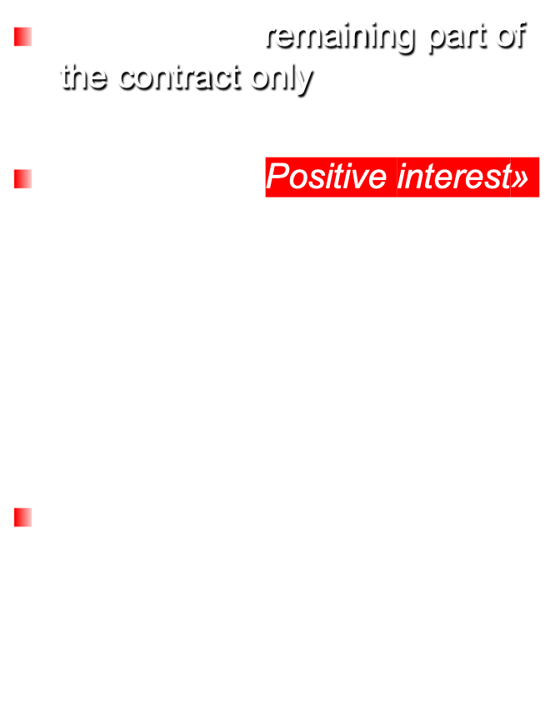
Compensation ex art. 17:
Webster –Matuzalem- De Sanctis
-

Slide 24

Termination
  “PROTECTED PERIOD”
  First 3 years or 3 football seasons for under 28
  First 2 years or 2 football seasons for over 28
  Renewal of contract = Renewal of the protected period

Slide 25

  Sports sanctions (discretionary power):
  For Players:
    4 - 6 month restriction from playing
    (6 for aggravating circumstance)
  For Clubs:
    Ban on registration of players for two registration periods.
    NO DISCRETION ON THE SEVERITY OF SANCTIONS
  For Any person subjet to FIFA Statutes and regulations: disciplinary sanctions
  Notification : immediate!
  THE “REPEATED” OFFENDERS ( 4 termination without just causes (no payments) in the last two years
  INDUCEMENT___ UNLESS PROVEN OTHERWISE!

Slide 26
Employment Contracts (art. 18)
Maximum of 5 years. For under 18:maximum of 3 years
Mention to the name of the agent
Approaching the player to enter negotiation:
  obligation to inform the current club
  Sign the new contrat within 6 months
It is not subject to :
  a positive medical examination and/or
  the granting of a work permit
Pre-contracts : essentialia negotii:
  identity of the parties,
  mutual acceptance of terms and conditions,
  Remuneration.
No grace Periods for payments (unless CBA)

Slide 27
Art. 24 Bis
Execution of monetary decisions
PSC/DRC
Outstanding amounts or compensation
Consequences:
  Club : ban on registration until the amount is paid (max of 3 entire and consecutive periods)
  Player:suspension until the amount is paid (max 6 months).

Slide 28
COACHES
Background:
RSTP and focus only on players
Coaches only recognised in RSTP for the purpose of dispute resolution (PSC)
Objective:
minimum regulatory framework with higher degree of legal certainty in their employment relationships and relevant international disputes

Slide 29
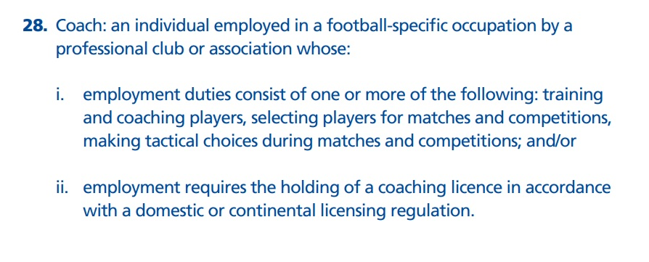
Definition of Coaches

Slide 30
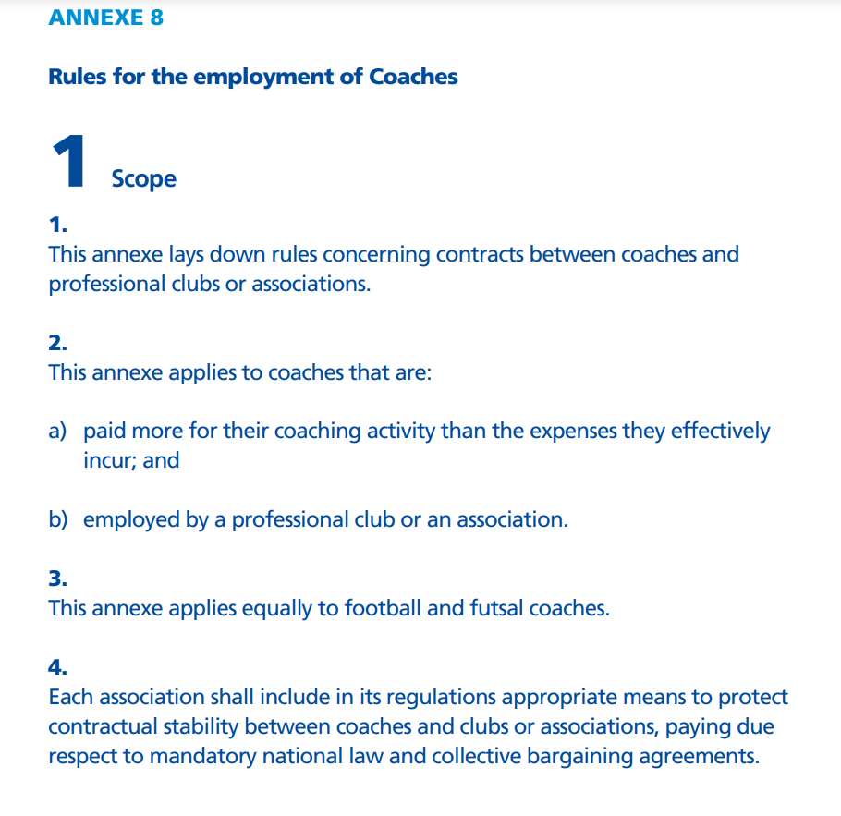
EMPLOYMENT CONTRACTS:
between professional clubs / coaches
between associations / coaches
Involving football or futsal coaches

Slide 31
LAST REFORM THE TRANSFER SYSTEM: KEY OBJECTIVES
PROTECTION OF MINORS
REWARDING TRAINING CLUBS
PROMOTING INVESTMENT IN YOUTH
SAFEGUARD THE INTEGRITY OF COMPETITIONS
ENSURING THAT MONEY STAYS WITHIN THE GAME
ACHIEVING GREATER TRANSPARENCY

Slide 32
International Transfer of Minors
FIFA FOOTBALL REPORT (page 25):
Applications: 3914 (in 2017-2018) - 9018 (in 2021 -2022)
Portugal : 1005
Spain: 895
USA: 792
Qatar: 749
Hungary: 299
Italy : 262
Guide To submit an application for Minors

Slide 33
International Transfer of Minors
NO INTERNATIONAL TRANSFER UNDER 18. BUT YES IF:
1. Parents move for reasons not linked to football
2. The transfer gof 16-18 the EU or EEA or 2 FA of the same country:
Adequate football education and training
Academic/ school education
Duty of care (accommodation, host family)
Proof of the above
3.100km distance (50 km) from a national border.
4. “Vulnerable” person, asylum seekers and without parents (humanitarian reasons) registered only for amateur clubs. If refugees also with Professional clubs
5. Students, without parents, temporarily in another country for academic reasons

Slide 34
PRIVATE ACADEMIES
Obligation for Club to Report to the FA:
  All minors (registered with the club or not)
  Any wrongdoing at private academie
Take all measures to protect minors
FA: keep register of minors

Slide 35
TRIALS (art. 19 ter)
Only if consent of the Club
Standard Trial Form (accommodation, meals, travel costs)
Duty of care (medical costs covered)
Duration:
  3 weeks for over 21
  8 weeks for players 21 years and under.
No training rewards

Slide 36
TRIALS for minors(art. 19 ter)
Only if trial during season of
  16th birthday
  15th if both P and C are domicilied in Europe
Written consent from the partents
Designation of a tutor (contact person)
Optimum accommodation and living standard
Notification to the current club
CBA: Additional conditions

Slide 37
International Transfers:
Take aways
DO NOT “PLAY” WITH THE RULES!
CAREFUL, PRECISE AND TRANSPARENT WHEN NEGOTIATING A CONTRACT:
  Waivers on Training compensation
  Sell on clause (and consequences)
  NET/GROSS Amounts
“INTERLOCUTORS”: Choose the reliable ones!
CULTURE… MATTERS!

