Slide 1

Safeguarding in Sport
Michele Colucci
www.colucci.eu - info@colucci.eu

Slide 2
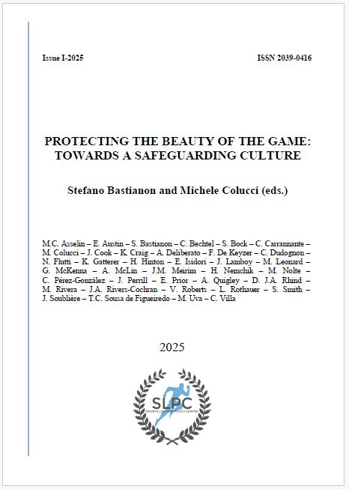
CONTENT
IOC
7 International Federations:
FIFA – FIBA –FIVB –FIG – IBU –UEFA –World Rugby
10 Countries
Australia –Belgium – Canada -France –Germany – Italy – Portugal-Spain – UK –USA
Lawyers –Psycologysts –Sociologists
Available on line : www.slpc.eu
Executive Summary in 12 languages: Arabic, Chinese, Japanese, Italian, Portuguese…

Slide 3

SAFEGUARDING
Protecting athletes from abuse, harassment, and exploitation.
Ensuring a safe environment and well-being of participants.
Maintaining integrity in sport.

Slide 4
International Legal Framework
Geneva Declaration
UN International Covenants
UN Convention on the Rights of the Child
UNESCO International Charter on Physical Education & Sport
International Convention against Doping in Sport
UN Convention against Corruption

Slide 5
GENEVA CONVENTION (1924)
“Mankind owes to the child the best that it has to give” (Article 1)
“The child must be given the means required for its normal development, both materially and spiritually” (Article 1).
“The child (…) must be protected against every form of exploitation” (Article 4).

Slide 6
1966 International Covenant on Civil and Political Rights (ICCPR) International Covenant on Economic, Social and Cultural Rights (ICESC)
“The Child has the right to be protected as required as a minor” (ICCPR, Article 24)
“Children and young persons should be protected from economic and social exploitation” (ICECS, Article 10)

Slide 7

United Nations Convention on the Rights of Child (UNCRC) 1989
“In all actions concerning children, whether undertaken by public or private social welfare institutions, courts of law, administrative authorities or legislative bodies, the best interests of the child shall be a primary consideration” (Article 3)

Slide 8
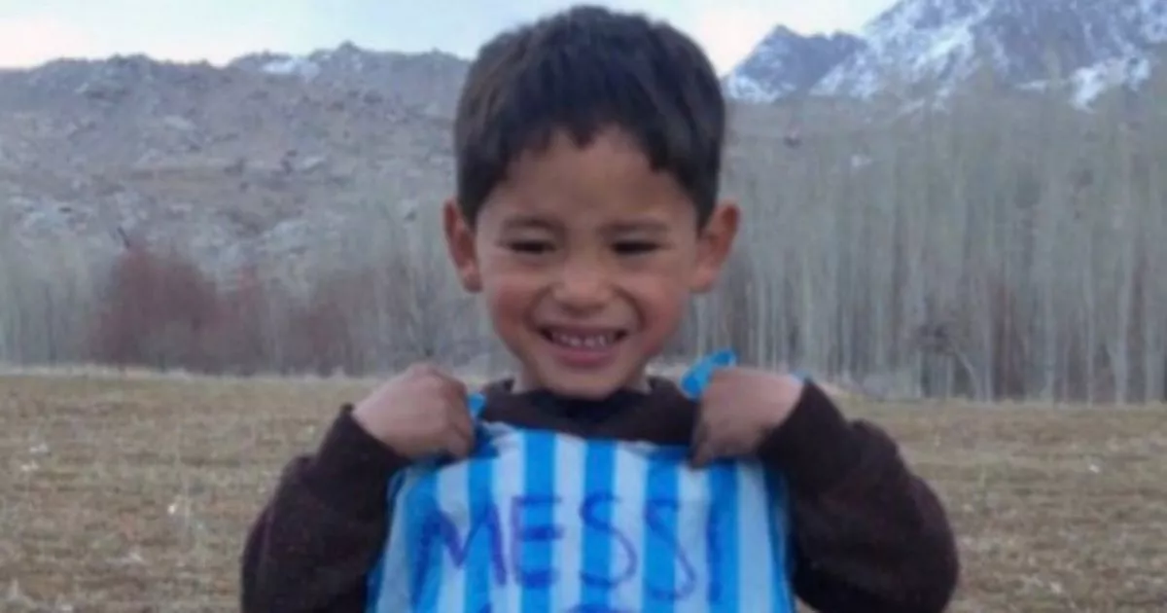
UNESCO International Charter of Physical Education, Physical Activity, and Sport (1978)
UNESCO International Charter of Physical Education, Physical Activity, and Sport (1978) The practice of sport as fundamental right for all (Article 1)
sport in a safe environment that protects the dignity, rights and health of all participants (Article 9.1)
sports stakeholders must be “conscious of the potential risks, especially for children, of dangerous or inappropriate training methods and competition, and psychological pressures of any kind”. (Article 9.4.)
“qualified personnel” dealing with children in sport, such as coaches, trainers, and volunteers musth attain and sustain the competence necessary to nurture the he rounded development and safety of all persons in their charge.
UNESCO International Charter of Physical Education, Physical Activity, and Sport (1978)

Slide 9
The UNESCO International Convention against Doping in Sport (2005)
DOPING – ABUSE
Protection of Athlets
Ethics and integrity
Encourage International Co-operation
Foster Research

Slide 10
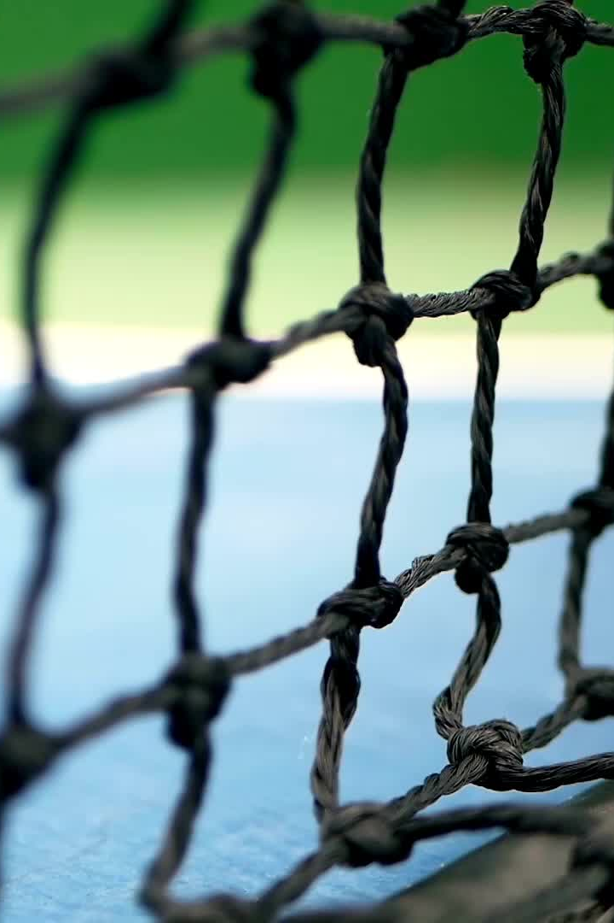
The UN Convention against Corruption (2004)
No reference to Sport
YET, Resolutions 7/8 and 8/4 on corruption in sport:
complaint systems, whistle-blower protection programmes, protected reporting systems, and effective witness protection measures,
promoting healthy lives and principles of integrity and to creating an atmosphere of intolerance towards corruption in junior and youth sport

Slide 11
Council of Europe 2007 The Convention on Protection of Children against Sexual Exploitation and Sexual Abuse
Sexual abuse of a child as a criminal offence (Article 18)
No Direct reference to Sport
Preventive measures: raising awareness, information programmes in primary and secondary schools

Slide 12
Council of Europe European Sports Charter
Everyone has the opportunity to take part in sport in a safe, secure and healthy environment (Article 1)
All stakeholders who shall respect and protect internationally recognised human rights and fundamental freedoms in sport (Article 7)

Slide 13
Council of Europe Other Instruments
1985
Convention on Spectator Violence and Misbehavior at Sports Events
1989
Anti-Doping Convention
2014
Convention on the Manipulation of Sports Competitions

Slide 14
The European Union 2000 Charter of Fundamental Rights of the European Union
Children have the right to protection and care!
The best interests of the child must be a primary consideration in all actions concerning them, whether taken by public authorities or private institutions (Article 24)

Slide 15
The European Union White Paper on Sport (2007)
Exploitation of young athletes (especially footballers)
Abandon of children not selected for competitions in a foreign country
Sexual abuse and harassment of minors in sport
Cooperation among Member States and Sports Governing Organisations (SGOs) :
Dissemination of existing legislation
Establishment of minimum standards and exchange of best practices

Slide 16

The European Union Article 165 TFEU Lisbon Treaty
“The Union shall contribute to the promotion of European sporting issues, while taking into account of the specific nature of sports, its structure based on voluntary activity and its social and educational function.
Moreover, the Union action shall be aimed, inter alia, at developing the European dimension of sport by protecting the physical and moral integrity of sportsmen and sportswomen, especially the youngest sportsmen and sportswomen”.

Slide 17
2019 Conclusions of the Council of the EU on Safeguarding Children in Sport
Call for a collettive commitment to protect children:
“keeping all children safe from harm, abuse, violence, exploitation and neglect”.
Raising Awareness:
Safeguarding measures:
Creating educational programs, codes of conduct, monitoring systems, and guidelines for preventing violence and abuse.
Procedures for managing allegations, conducting appropriate follow-up
Collaboration across various sectors and actors :
- Schools, sports organizations and clubs, families, physicians, coaches, teachers, sports officials,

Slide 18

European Parliament Resolution of 7 October 2025
Role of EU policies in shaping the European Sport Model:
It called on all stakeholders to intensify their efforts to promote safe, inclusive and equitable sport, accessible to all, including persons with disabilities, with a focus on promoting equality between men and women, combating all forms of violence, discrimination and harassment and improving the accessibility of sports infrastructure.

Slide 19
Some Proposals
UNESCO CONVENTION ON SAFEGUARDING
EU DIRECTIVE based on non discrimination, internal market, health and safety
SAFE DAY via the Erasmus Programme

Slide 20

The IOC Charter
IOC Values and Principles: Respect, Peace, Fairplay, non-discrimination
Human Dignity and Well-being of Athletes
« Shared Responsibility » (Article 2)
Olympic Games as a « Safe space where everyone is protected from harm » (Article 3)
Fostering a “Cultural Transformation” through Olympic Values

Slide 21
IOC Code of Ethics
« Culture of Ethics and Integrity »
Respect for :
Principle of Universality, Political Neutrality
Olympic Spirit
International Conventions on Human Rights
Human Dignity

Slide 22
The IOC Framework for Safeguarding Athletes and Other Participants
Priority: safety and well-being of all inolved
Highest standards of conduct
NOC Accredited Welfare Officers (Article 7)
IOC Safeguarding Officers (Article 8)

Slide 23
The IOC Framework for Safeguarding Athletes and Other Participants
BE AWARE OF ONE’S OWN BEHAVIOUR :
STAY CALM !
TRY TO LISTEN ACTIVELY!
DO NOT PREJUDGE OR MAKE NEGATIVE COMMENTS ABOUT THE PERSON BEING ACCUSED
AVOID ASKING PROBING OR LEADING QUESTIONS
DO NOT MAKE PROMISE THAT CANNOT BE KEPT
ENSURE CONFIDENTIALITY
IT IS NOT YOUR RESPONSIBILITY TO OPEN AN INVESTIGATION
KEEP THE ATHLETE/VICTIM INFORMED ABOUT THE FOLLOWING STEPS
ASSESS THE RISK OF HARM. IF SO, REPORT IT IMMEDIATELY!

Slide 24

The IOC Safeguarding Toolkit
Benchmarking exercise and to do lists
Best practices and templates, clear definitions
Reporting Mechanisms and Confidentiality
Dedicated Safeguarding Officers
Education, Training, and Raising Awareness
Managing Cases and Investigations (transparency and fairness)
Implementation: Bronze, Silver, and Gold medals
But No Monitoring

Slide 25
2007 IOC CONSENSUS STATEMENT Sexual Harassment and Abuse in Sport
Sexual harassment and abuse in sport happen in all sports and at all levels!
Members of the athlete’s entourage and peer athletes appear to be the primary perpetrators
Perpetrators are usually males
Risk situations are: the locker-room, the playing field, trips away, the coach’s car and social events

Slide 26
2016 IOC CONSENSUS STATEMENT on Harassment and Abuse (non-accidental violence) in Sport
Some risks to young athletes are unique to sport:
the coach-athlete relationship, intensity of sport practice,
athlete recruitment practices, relocation of minors to a distant training facility,
varied training locations and times, separation from family or school communities due to sports participation,
sport initiation and hazing practices.
Athletes with disabilities experience from two to three times increased risk of psychological, physical and sexual abuse and harassment when compared with youth athletes in general.

Slide 27
2024 IOC CONSENSUS STATEMENT interpersonal violence and safeguarding in sport
Definition of “Safeguarding” :
“All proactive measures to both prevent and appropriately respond to concerns related to harassment and abuse in sport as well as the promotion of holistic approaches to athlete welfare”.
5 Recommendations:
1. Address safe sport as everybody’s responsibility;
2. recognise that safe sport is for all within the sports ecosystem;
3. Encourage awareness, adoption and implementation of current scientific knowledge on safeguarding in sport;
4. Encourage sport that is athlete centred, emphasising mutual care and respect;
5. Outreach to unheard voices and integrate global perspectives into safe sport.

Slide 28
INTERNATIONAL SPORTS FEDERATIONS: SHARED PRINCIPLES
INTEGRITY
ACCOUNTABILITY
TRANSPARENCE
CONFIDENTIALITY
PREVENTION
INDIPENDENCE
IMPARTIALITY

Slide 29
Safeguarding Policies of Major Sports Federations
FIFA CODE OF ETHICS (2024):
ZERO TOLERANCE
GUARDIANS PROGRAMME
Safe Football Support Unit
FIBA Zero Tolerance
Receive
Reassure
React
Record
World Rugby: Player welfare & safeguarding training.
UEFA: Child safeguarding toolkit with Terre des hommes.

Slide 30
CONCLUSION
Cultural switch requires time!
Policies, education, and enforcement are key.
Call to action: Prioritize safeguarding at every level.

