Slide 1
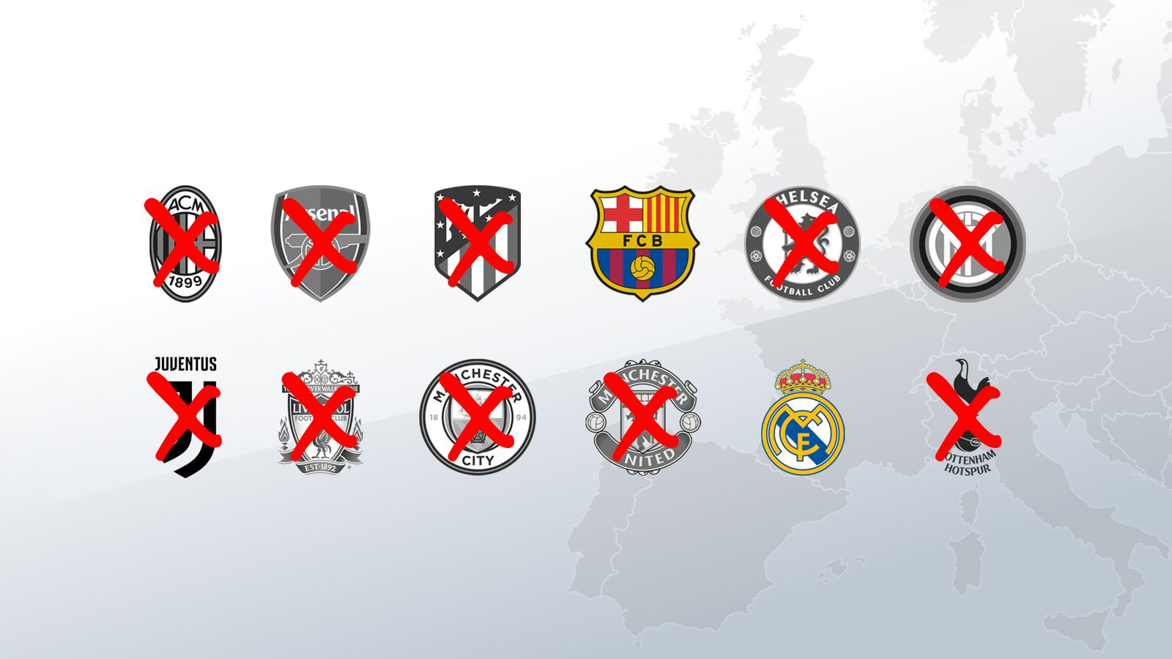
THE SUPERLEAGUE CASE
ESLC v.FIFA and UEFA
(A22 Sports Management – RFEF-LNFP) by Michele Colucci

Slide 2
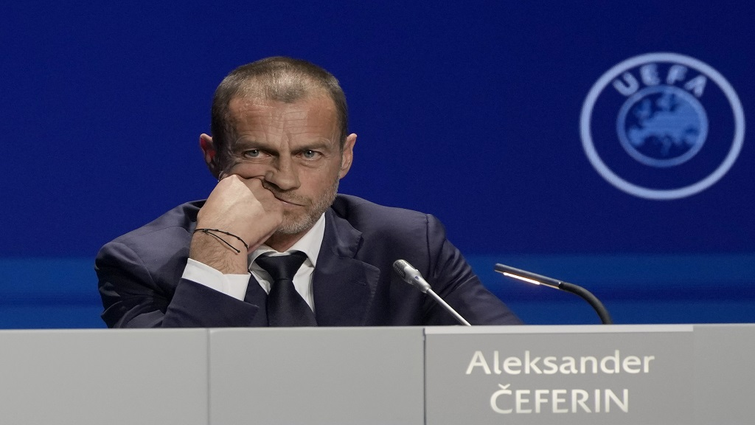
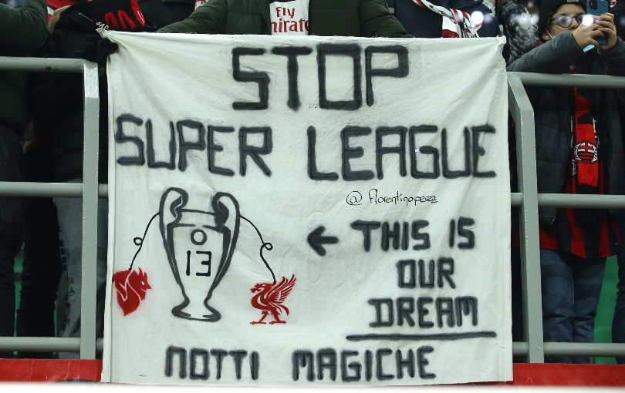

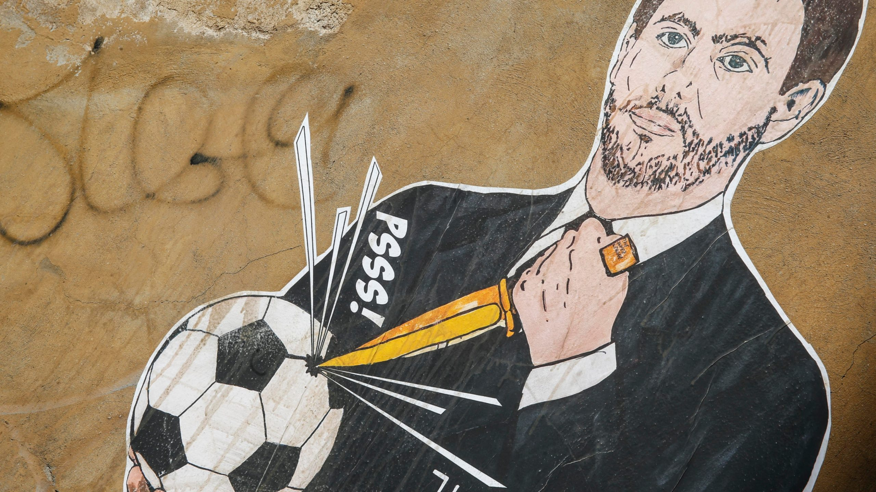
21 January 2021

Slide 3

The Super League Project
European Superleague Company SL
Nature: Private Company under Spanish Law (12 clubs)
Goal: new International interclub competitions
Means:
3 companies for:
Management of the competition
Exploitation of media rights
Exploitation of other commercial rights
JP Morgan : financial support (4 billion EUR)

Slide 4

Three Rules at stake
FIFA-UEFA “prior approval” rules of any international football competitions
Clauses obliging Clubs and Players to participate only to their competitions, on pain of exclusion.
Provisions for FIFA and UEFA as “original owners” of all sporting rights (“exclusive exploitation”)

Slide 5
Six Preliminary Questions on FIFA and UEFA Rules
Prior Authorization: Art.102 TFEU on abuse dominant position
Prior authorization: Art. 101 TFEU on free competition
Threat of sanctions: Artt. 101 and 102 TFEU
“Original Owners of rights”: Artt. 101 and 102 TFEU
Prior Authorization “exception” : Art.101 (3) and 102 TFEU
Prior Authorization: Artt. 45-49 -56 and 63 TFEU (freedom of movement)

Slide 6

Art. 165 TFUE
EU: support coordination and supplement to Member States in Sport
Promotion of European Dimension of Sport
Foster co-operation with third countries
It allows to pursue an Action and not a Policy on Sport (para. 99)
It is not a cross-cutting provision having a general application (para.100)
Specific nature but not exception for Sport n the application of the Treaty (para.104)
Specific assessment (Sports are not all the same: different level of professionalism)

Slide 7
Art. 165 TFUE
In the eyes of two Advocate Generals
Superleague case
  Social Provision
  Horizontal provision for all EU policies
  Constitutionalisation of “sports law”…
  Thus derogation to other EU principles
HGP case
  Addressed to EU and not to MS and private Associations
  Wording of soft law
  Professional and recreational sports
  Clubs and individuals
  “false legal basis”

Slide 8

Is Prior Approval in line with Art. 102 TFEU?
UEFA – FIFA dominant position
“Special responsibility” :
Prevent undistorted competition
Not unduly deny access to the market ( para.131)

Slide 9
UEFA AND ITS DUAL ROLE
REGULATORY
ECONOMIC

Slide 10

POWER TO:
AUTHORISE AND SETTING UP A NEW COMPETITION
CONTROL THE PARTICIPATION OF FOOTBALL CLUBS AND PLAYERS
SANCTIONS

Slide 11
CONFLICT OF INTEREST BUT IT IS LEGITIMATE TO HAVE:
Common rules for homogeneity and coordination of competitions, equal opportunities and merits (para.144)
Prior authorization system (para.145)
Sanctions (para.146)
BUT…

Slide 12

Compliance with Art. 102 TFEU
FEDERATIONS NEED TO HAVE (paras 147-148):
SUBSTANTIVE CRITERIA and DETAILED PROCEDURAL RULES:
TRANSPARENCY
OBJECTIVITY (no discretion)
PRECISION
NON DISCRIMINATION

Slide 13

Compliance with Art. 102 TFEU
Proportionality of sanctions (para.148)
Accessibility of Rules prior to their implementation (para.151)
Irrelevant that new competitions are not subject to FIFA and UEFA rules because of their control on national football associations, clubs and players

Slide 14

Compliance with Art. 102 TFEU
CONCLUSIONS
UEFA and FIFA prior approval system is an abuse of dominant position!

Slide 15

Art. 101 TFEU
FIFA and UEFA Prior Authorization =
    Obligation for players and clubs to participate to their competitions +
    Prohibition to participate in “third competitions”
    Sanctions

Slide 16
Art. 101 TFEU
Agreement having an anticompetitive object? namely:
  Collusive conduct leading to price fixing
  Limitation on production capacity
  Horizontal agreements leading to exclusion of competitive undertakings (para.164)

Slide 17
UEFA and FIFA :“Dual Role”
Undertaking and Association of Undertaking
Regulatory role: adopting rules for professional football
Economic role: organizing sporting competitions
Giving the power to:
Authorise the setting up and organization of new competition
Control the participation of professional football clubs and players, on pain of sanction (171)

Slide 18
Consequences (para.173):
IF No FIFA (and national association)’s Approval
No Creation of other international Leagues
Players and clubs cannot play and cannot make sports contacts with no affiliated players and clubs

Slide 19
Consequences (para.173):
No FIFA and UEFA approval …
No match and no competition
No participation in other competitions of other national associations

Slide 20

LEGITIMATE OBJECTIVES
Observance of:
Principles
Values, and
Rules of the game (para.176)

Slide 21
BUT…NO:
SUBSTANTIVE CRITERIA
DETAILED PROCEDURAL RULES
TRANSPARENCY, OBJECTIVITY, NON- DISCRIMINATION (para.175)

Slide 22
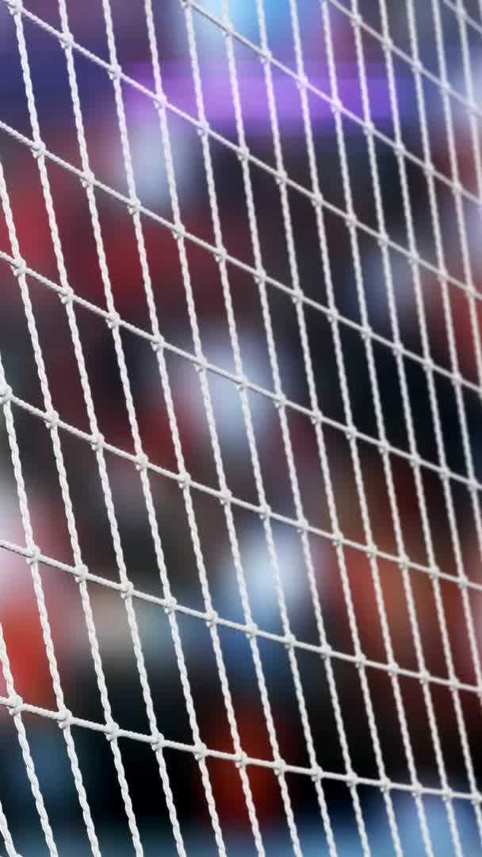
Consequences
FIFA and UEFA RULES:
“if not exclude” competitors from the market, they restrict the creation of alternative and “innovative” formats
Spectators cannot attend those competitions (para.176)
Reinforce the barrier to entry in the market (para.177) because third entities clubs and players (vulnerable for sanctions)

Slide 23

CONCLUSIONS:
FIFA AND UEFA RULES CONTRARY TO ART.101 TFEU

Slide 24

ARE SANCTIONS against Art. 101 and 102 TFEU?
  OF COURSE THEY ARE!
  THEY AIM TO IMPLEMENT AN ILLEGAL REGIME (para.180)

Slide 25


Exemptions?
Artt. 101 (3) and 102 TFEU
    FOUR cumulative conditions:
    1. The agreement result in efficiency gains
    2. Consumers receive a fair share of the benefits
    3.Restrictions are necessary to achieving those benefits
    4.There is no substantial elimination of competition

Slide 26
Exemptions
BURDEN OF PROOF ON FIFA AND UEFA
NATIONAL JUDGE will decide if favourable impact on ”users”:
National football associations
Professional or amateur clubs
Professional or amateur players
Young players
Spectators and TV viewers
BUT also ”solidarity contribution”

Slide 27

HINT (para. 99):
    No substantive criteria and no detailed procedural rules
    No transparency, clarity neutrality, precision and proportionality…
    Prevention of any and all competition on the market

Slide 28

Exploitation of all rights relating to sports competitions
Artt. 101 and 102 TFEU
FIFA and UEFA “original owners”
FIFA : exclusive power on exploitation and use of those rights

Slide 29
CONSEQUENCES
No access to clubs in the marketing of those rights
No access to third undertakings
Detrimental for consumers and TV users
Standardization of Buyers’ conduct
Less choice and less innovation

Slide 30
THUS:
RESTRICTION OF COMPETITION AND ABUSE OF DOMINANT POSITION

Slide 31
Exploitation of rights relating to sporting competitions
Artt. 101 and 102 TFEU : JUSTIFICATIONS
GENUINE FINANCIAL SOLIDARITY (para.235)
BETTER PRODUCTION AND REDISTRIBUTION RIGHT
CONCRETE EVIDENCE FOR THE NATIONAL JUDGE (para.236)

Slide 32

Compatibility with EU Freedom to provide services :
    Art. 56 TFEU: NO to rules prohibiting, impeding or rendering less attractive the activity of service providers
    PRIOR Authorization as obstacle to Freedom to provide services for third organisers and clubs
    Obstacle to freedom of movement

Slide 33
What’s next?
- ALL SPORTS (INTERNATIONAL AND NATIONAL° FEDERATIONS NEED TO COMPLY
- CONTROL BY THE EUROPEAN COMMISSION
33

