Slide 1
TRANSFER OF PLAYERS AND TERMINATION OF CONTRACT WITHOUT JUST CAUSE
Michele Colucci
Member of the Dispute Resolution Chamber
FIFA FOOTBALL TRIBUNAL
info@colucci.eu - www.colucci.eu

Slide 2
Recent and Pending International Sports Cases before the EU Judges
Superleague against UEFA and FIFA
FC Antwerp against UEFA (homegrown player rule)
International Skating Union
Diarra v. FIFA
The International Match Calendar
Seraing v. FIFA
Football Agents against FIFA
The CD Tondela case

Slide 3
SPORT AND THE EUROPEAN UNION
Member States - 447.000.000 people - area of 4,233,255.3 km²
^{ONE SINGLE MARKET}
3

Slide 4
EU FUNDAMENTAL FREEDOMS
FREEDOM OF MOVEMENT (for workers)
No direct or indirect discrimination (Art. 45 TFEU)
FREEDOM OF COMPETITION (for undertakings) (Art. 101 TFEU)
No Abuse of Dominant Position (Art. 102 TFEU)

Slide 5
EU INTERNAL MARKET: FREE MOVEMENT OF WORKERS
Art.45 TFEU : “Workers” have the right to:
accept offers of employment actually made;
move freely within the territory of Member States for this purpose;
to stay in a Member State for the purpose of employment;
to remain in the territory of a Member State after having been employed in that State.

Slide 6

EQUAL TREATMENT
BAN ON “DIRECT” DISCRIMINATIONS
Art. 18 TFEU on the basis of nationality
Art. 45 TFEU:…
Access to employment
Pay
Employment conditions
BAN ON “INDIRECT” DISCRIMINATIONS (UEFA Home Grown Player Rule ?)
NO INDIRECT DISCRIMINATION : based on criteria other than nationality but leading to the same result

Slide 7
SPORT AND EU COMPETITION LAW : Art. 101 (1)
Are prohibited and automatically void :
Decisions, Agreements, Concerted Practices
Undertakings or associations of undertaking
Affecting trade between Member States
By Object or by Effect
Prevention, Restriction or Distortion of Competition

Slide 8
SPORT AND EU COMPETITION LAW: Art. 101 (3) The four cumulative exceptions
The Agreement results in efficiency gains
Consumers receive a fair share of the benefits
The restrictions are indispensable of achieving those benefits
There is no substantial elimination of competition

Slide 9
SPORT AND EU COMPETITION LAW: Art.102 (TFEU)
No to any abuse of dominant position by one or more undertakings

Slide 10
THE GENESIS: Bosman v. URSBFA - UEFA - FIFA DAVID v. GOLIATH

Slide 11
Salary :120.000 BEF= 3000 euros Offer for a renewal of 750 euros Transfer Fee (after the exspiration of contract (11.570.000 BEF = 200.000 euros)
WHY 200.000 euros ?
How was it calculated?

Slide 12
TRANSFER FEE
Obstacle because it affects players’ access to the employment market in other Member States
No valid justifications: maintenance of sportive and competitive balance between clubs
Other alternative measures: marketing, ticketing, TV rights
Conclusions: Transfer fee after the end of the contract against EU law

Slide 13
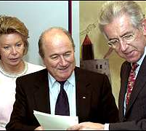
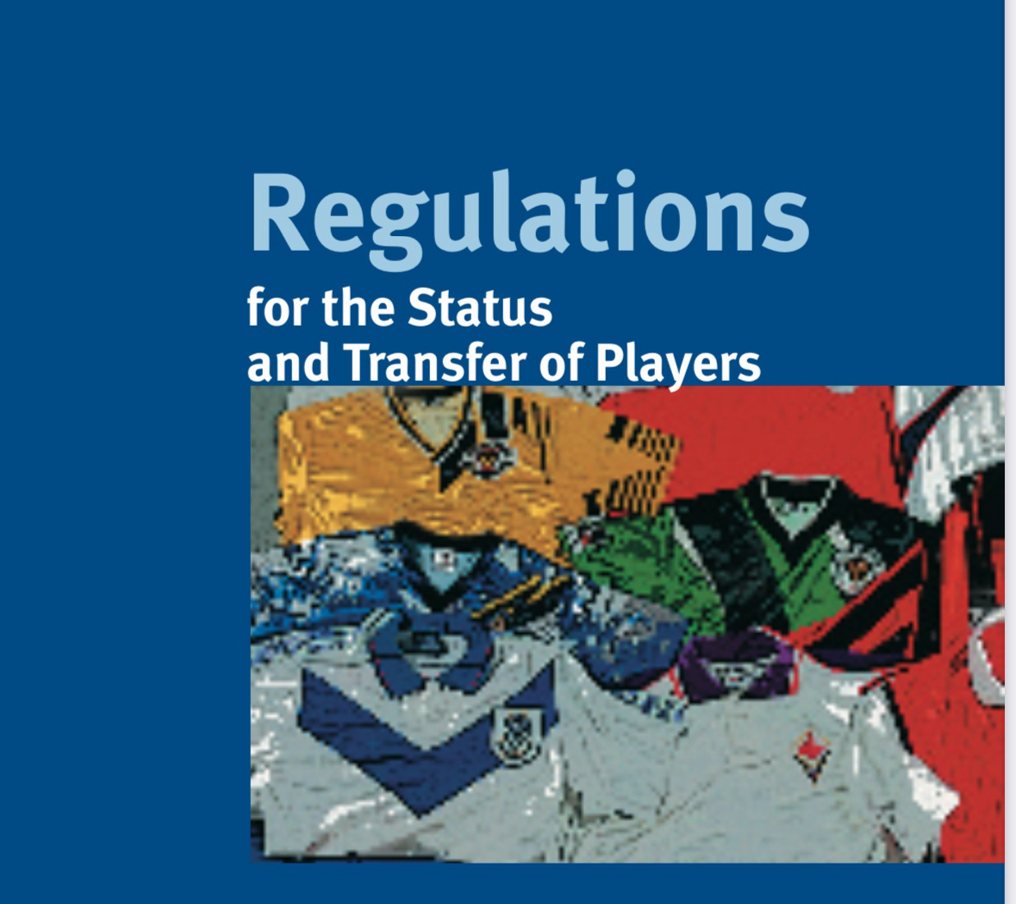
.
«Gentlemen’s Agreement »
2001 Main Principles :
Contractual stability
economic and sporting sanctions,
ITC and joint liability
Training compensation
Solidarity mechanism
Protection of minors
Dispute resolution system
Freedom to submit disputes to ordinary courts

Slide 14
CONTRACTUAL STABILITY “PACTA SUNT SERVANDA”

Slide 15

Respect of the Contract (Art. 13)
Termination upon expiry
Mutual Agreement
If (and only if) the transfer before end of contract, a transfer fee is allowed.

Slide 16
Termination for Just Cause
Either Parties may terminate a contract ”without consequences of any kind” for just cause (Art. 14.1)
“Abusive” Conduct (Art.14.2)

Slide 17
JUST CAUSE
“Valid Reason” (DRC)
”Good Cause” when the fundamental terms and conditions of contract are not respected. (CAS)
“Sufficient serious reasons”, impossibility to continue the employment relationship
ULTIMA RATIO (action of last resort)
Previous warning (unauthorized absences, misbehavior during training)

Slide 18
Just causes invoked
Poor ”sporting” performance: NO!
Medical Negligence (Appiah case)
Deregistration or Non –Registration (quota): protection of personality right/no need of a default notice.(“actual termination of the employment contract (CAS 2015/A/4122)

Slide 19
Just causes invoked
Visa and work permit
Termination as disciplinary sanction(no! ultima ratio)
Leaving without authorization or failing to return after authorized leave
Request to return
Reasonable deadline
(The Ortega case)

Slide 20
Abusive conduct
Force the other party to terminate the contract or to change the terms of contract. “Case by case” analysis.
On the club’side (burden of proof on player):
Training alone (for how long?), without supervision by coaching staff, 3 pm in the desert…
No participation in any Club’s outside activities
No use of medical and physiotherapy facilities
Leave the apartment/car
On the player 'side (burden of proof on club):
Refusal to train, to play (adducing various excuses)

Slide 21
Outstanding salaries (Art. 14 bis)
Two-months salary (or pro rata equivalent to two months)
Notice in writing: 15 days to comply
Not necessary,If clear that the club does not want to comply with the contract! Still, better to notify.
But National CBAs…

Slide 22

Sporting Just Cause (Art.15)
“Established” professionals (only players):
Age, past performance, end of training period( 21 years old), experience of teammates.
Less than 10 %of Official matches
Compensation but no sporting sanctions

Slide 23

No termination during the contract (Art.16)
Unless just cause
As a Guarantee for both Clubs and Players

Slide 24
Art. 17 RSTP Consequences for Termination without just cause
ECONOMIC CONSEQUENCES
COMPENSATION (ALWAYS DUE!)
SPORTING CONSEQUENCES

Slide 25

Calculating compensation: “UNLESS PROVIDED IN THE CONTRACT…”
Contractual compensation clauses
Liquidated damages clauses (estimation of compensation in advance).
Proportionate otherwise invalid (DRC)
It may be adjusted to a reasonable and appropriate level
Reciprocal otherwise invalid (DRC)
No necessarily reciprocal (CAS)
Buy-out clauses: right to terminate by paying unconditionally a sum.
No damages/ no sporting sanctions.

Slide 26
Art. 17 (1) Criteria to follow in case compensation is not provided in the contract…
Law of the relevant country
Specificity of Sport, and
Any other “objective” criteria:
Remuneration and other benefits due to the player under the current and new contract
Time remaining under existing contract
Fees and expenses paid or incurred by the former club (amortised under the terms of the contract

Slide 27
Art. 17(2) Joint Liability
“If a professional player is required to pay compensation, the professional player and his new club shall be jointly and severally liable for the payment of such compensation. The amount may be stipulated in the contract or agreed between the parties”.

Slide 28
COMPENSATION TO THE PLAYER
Residual value of the contract (i.e. "damages")
If mitigation because of a new contract: residual value of contract minus new contract
If termination due to overdue payables: additional compensation of 3 salaries can be awarded
If “egregious circumstances”: additional compensation can be up to 6 monthly salaries
Compensation can never exceed the residual value of the contract

Slide 29
DRC COMPENSATION TO THE CLUB
Average between new and old contract:
Value of the old contract
Period between termination and original expiry date of the contract
Value of the new contract
Period between starting date and original expiry date of the old contract
Other factors:
Non amortised transfer costs (disputed)
Directly replacement costs

Slide 30
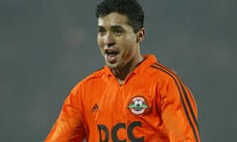
CAS: calculation of compensation
WEBSTER case
MATUZALEM case
Remaining part of the contract
Positive Interest
Restitutio ad integrum
Tranfer value
New remuneration less saved salaries
Specificity of Sport

Slide 31

“PROTECTED PERIOD”
First 3 years or 3 football seasons for under 28
First 2 years or 2 football seasons for over 28
Renewal of contract = Renewal of the protected period

Slide 32
Art. 17(4) Sporting Sanctions
Sports sanctions (alleged discretionary power):
For Players:
4 - 6 month restriction from playing
(6 for aggravating circumstance)
For Clubs:
Ban on registration of players for two registration periods.
NO DISCRETION ON THE SEVERITY OF SANCTIONS
For any person subject to FIFA Statutes and regulations: disciplinary sanctions
Notification : immediate!
THE “REPEATED” OFFENDERS ( 4 terminations without just causes (no payments) in the last two years
INDUCEMENT___ UNLESS PROVEN OTHERWISE!

Slide 33
THE DIARRA CASE
Judgement of the Court of Justice of 4 October 2024
Case C-650/22
FIFA v. BZ

Slide 34
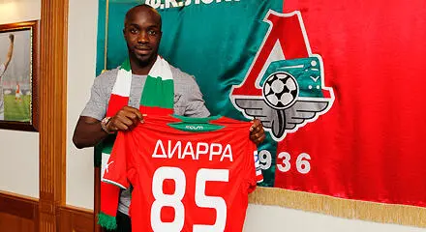
The DIARRA Case
Termination without just cause:
Non authorized absence, no training
DRC and CAS: 10.500.000 euros compensation to Lokomotive Moscow (unamortized transfer fee!)
Belgian Club Charleroi interested but…
No clearance from FIFA and URBSFA
Case before national judge : claim 6 millions Euros as loss of earnings – Preliminary questions for ECJ

Slide 35

THE FIFA TRANSFER RULES AT STAKE
Art.17 RSTP (Consequences of breach of contract without “just cause”)
Art. 17 (1): Compensation and criteria to determine it
Art. 17(2) Joint liability player and new club
Art. 17 (4) Sporting sanctions
Art. 9 and Art. 8 Annex 3 RSTP

Slide 36
Preliminary Questions to the Court of Justice
Are the FIFA rules (art. 17 and Art. 9 RSTP) against:
Freedom of Movement of Workers (Art. 45 TFEU)?
Freedom of Competition (Art. 101 TFEU)?

Slide 37
Are FIFA rules an obstacle to Freedom of Movement?
YES OF COURSE: they are deterrent for clubs in hiring players:
“Significant legal risks”
”Unpredictable and potentially very high financial risks”
“Major sporting risks”(para.92)

Slide 38
Are they justified? FIFA claimed Legitimate Objectives
Protection of players (no!) (para.99)
Ensuring regularity of competition, via transfer windows: yes!(para.100)
Stability of contracts and maintenance of a certain degree of stability in club’s squad (not per se a legitimate objective) BUT a mean to ensure “the regularity of interclub fooball competitions” (paras101-102)

Slide 39
ARE THEY PROPORTIONATE?NO !!!
“they go beyond and even, in the case of some of them far beyond, what is necessary to achieve their objective”…
They “apply for a considerable period of time” to players whose careers are moreover relatively short” (para. 104)

Slide 40
Art. 17 (1) RSTP
“Without just cause” not presicely defined
“Law in force in the country concerned”…never applied.
”Specificity of sport” : general concept, not an ”objective criterion..leading to “discretionary implemntation”, unforeseeable and difficul to control (para. 106)

Slide 41
Art. 17 (1) RSTP
Remuneration and other benefits under new employment contract, thus extraneous elements to the terminated employment relationship, not necessary, not justified.
All the costs and expense incurred by the former club, “particularly excessive” whereas the player did not participate in those negotiations. They were agreed among clubs to “protect their financial interests”.
This is confirmed by the DRC and CAS jurisprudence. (para.107). (Matuzalem case: positive interest!)

Slide 42
Art. 17 (2) Joint Liability: disproportionate!
Does not take into account the circumstances of each individual case
Compensation based on questionable criteria (“deficiencies” in the light of EU law)
The non application to a new club signing a contract with the player after the expiration of the previous contract , is not provided in the Regulations and thus there is no legal certainty! (para.108)

Slide 43
Art. 17 (4) Sporting Sanctions
Sporting sanctions may be justified BUT ONLY if governed by :
TRANSPARENT, OBJECTIVE, NON-DISCRIMINATORY AND PROPORTIONATE CRITERIA!
No to Sporting sanctions based on automatic presumptions!.. But yes to “sufficient evidence” for inducement to breach a contract (paras. 110,-111)

Slide 44
ITC Article 8.2.7 of Annex 3 RSTP
Non release of ITC pending an employment dispute
Disproportionate because:
It disregards the circumstances of each case (the factual context)
The conduct of the player and his former club
The role or lack of role played by the new club
The Rules do not refer to such a possibility

Slide 45
Conclusions on the basis of Art. 45 TFEU
No to joint responsibility based on criteria ”which are sometimes:
imprecise or discretionary;
Laking any objective link with the employment relationship concerned;
Disproportionate.”
No to sporting sanctions on the basis of mere presumption
No to the ITC

Slide 46
Art. 101 TFEU: Freedom of competition
All agreements between undertakings, decisions by associations of undertakings and concerted practices which may affet trade between Member States and which have their object or effect the prevention, restriction or distortion of competition whin the internal market, are null and void”

Slide 47
Applied to Football
Collusive conduct may consist in limiting or controlloing the recruitment of high-level workers, such as players already trained in the professional football sector.(para. 129)
Analysis of the substance of agreements
Economic and Legal context

Slide 48
Legal Context: Criteria in the Art. 17 (1)
Law of the country: “dead letter”
Specificity of sport “general and imprecise”
“other criteria” leading to extremely high and dissuasive damages
Reference to Belgian Employment law:
Compensation= remaining remuneration until the end of the contract (para. 135)

Slide 49
Legal Context: ITC and Joint Liability
They restrict generally and drastically the competition in the recruitment of players already recruited by other clubs
Substantial and highly unpredictable compensation
No ITC = no possibility to play(paras 138 and 139)

Slide 50
What are Sports Associations allowed to do?
To adopt, implement and enforce rules related to the organization of competitions
To adopt and impose common rules for uniformity and co-ordinationation
To regulate the composition of teams
To adopt sanctions/penalties (para.143)
To ensure the stability of the composition of the pool of players (by prohibiting unilateral termination during the season (Art. 16) RSTP (para. 144). BUT….

Slide 51
What is prohibited to Football Clubs to do ?
No to the acceptance of any generealised drastic and permanent restriction or even prevention of any possibility for clubs to recruit players already employed by other clubs when the contract has been allegedely terminated without just cause”
No to“No-poaching” agreements between clubs resulting in the artificial partitioning of national an local markets, to the benefits of all clubs. (para. 145)

Slide 52
THUS FIFA RULES
FREEZE the market (para. 146)
They are “a clear restriction on the market” (para. 146)
Restriction by object (para. 148)
No possible expection under Art. 101(3)TFEU because…
1.Discretionary and/or disproportionate
2. Not necessary.
Contrary to EU Competition Law.

Slide 53

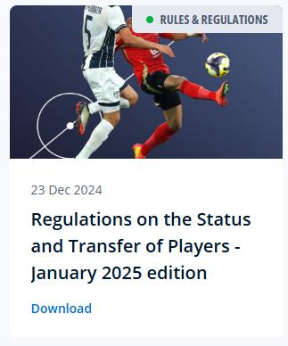
FIFA RSTP

Slide 54
Art. 17.1
Until 31.12.2024
As of 1.1.2025
In all cases, the party in breach shall pay compensation. Subject to the provisions of article 20 and Annexe 4 in relation to training compensation, and unless otherwise provided for in the contract, compensation for the breach shall be calculated with due consideration for the law of the country concerned
In all cases, the party that has suffered a damage as a result of a breach of contract by the counterparty shall be entitled to receive compensation. Subject to the provisions of article 20 and Annexe 4 in relation to training compensation, and unless otherwise provided for in the contract, compensation for the breach shall be calculated taking into account… with due consideration for the law of the country concerned.

Slide 55
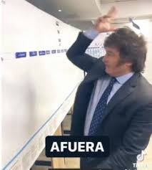
Art. 17.1
Until 31.12.2024
As of 1.1.2025
The specificity of sport, and any other objective criteria. These criteria shall include, in particular, the remuneration and other benefits due to the player under the existing contract and/or the new contract, the time remaining on the existing contract up to a maximum of five years, the fees and expenses paid or incurred by the former club (amortised over the term of the contract) and whether the contractual breach falls within a protected period.
The damage suffered, according to the “positive interest” principle, having regard to the individual facts and circumstances of each case.

Slide 56
Art. 17.2
Until 31.12.2024
As of 1.1.2025
If a professional is required to pay compensation, the professional and his new club shall be jointly and severally liable for its payment. The amount may be stipulated in the contract or agreed between the parties.
A player’s new club shall be held jointly liable to pay compensation if, having regard to the individual facts and circumstances of each case, it can be established that the new club induced the player to breach their contract.

Slide 57
Art. 17.4
Until 31.12.2024
As of 1.1.2025
If a professional is required to pay compensation, the professional and his new club shall be jointly and severally liable for its payment. The amount may be stipulated in the contract or agreed between the parties.
A player’s new club shall be held jointly liable to pay compensation if, having regard to the individual facts and circumstances of each case, it can be established that the new club induced the player to breach their contract.

Slide 58
FIFA RSTP
Before Diarra
RSTP until 31.12.2024
After Diarra
RSTP as of 1.1 2025
No definition of Just cause
National law (not applied)
Specificity of Sport
Remuneration and other benefits under new contract
All costs and expenses made by the former club
Automatic Joint Liability
No, ITC if pending dispute
Definition of Just cause
National law (to be applied)
No Specificity of Sport
No reference to the new contract
No reference BUT damage suffered“positive interest”
No automatic Joint Liability
Yes, ITC even if pending dispute

Slide 59
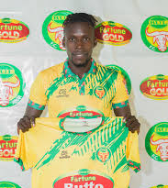
FIFA - DRC JURISPRUDENCE
Massafi Al-Jonob, Iraq
vs
Musa Esenu, Uganda
& Bul Football Club,
Uganda
(published on 19 November 2025)

Slide 60
KEY FACTS AND DATES
11 January 2024: Contract signed between player and Al-Jonob for 4.5 months
15 January 2024: Contract signed between player and FC Bul for 1.5 years
4 February 2024: Al-Jonob notifies the Player of a breach of contract
14 February 2024: Player informs Al-Jonob that he terminated the contract for ‘personal reasons’ (sic!)

Slide 61
DRC Decision: Just Cause
Art. 18, para. 5 , FIFA RSTP: a player cannot sign two contracts covering the same period of time.
Contract already terminated when player signed with FC Bul.
Player clearly terminated the contract without just cause and compensation is due.

Slide 62
DRC Decision: claims and awarded compensation
USD 13,500 as the rest value of the contract – an appropriate starting point for the calculation (majority)
- USD 700 as the costs for a flight ticket – potentially a damage to be reimbursed but not in this case
- USD 405 as a registration fee – rejected as not proven
- USD 21,000 for the specificity of sport – rejected as no longer an element included in art. 17 FIFA RSTP
- USD 15,000 as the replacement costs of the player – rejected as in this case no logical nexus
- USD 2,000 for losing the opportunity to utilise the player’s image rights – rejected as not proven
Compensation: USD 13,500 (by majority)
Sporting sanctions: No sanctions (by majority)

Slide 63
DRC: JOINT LIABILITY
Art. 17 par. 2 FIFA RSTP: joint liability only applicable if Al-Jonob can prove that
There was no evidence to indicate that FC Bul induced the player to breach his contract with Al-Jonob.
FC Bul could not have known that the player was registered with Al-Jonob
given that the ITC had not yet been confirmed in FIFA TMS.
- No joint liability

Slide 64
What is next?
On-Going Reform of Art. 17 RSTP
Review of the calculation of compensation
More consideration of National Law?
From Regulation to Collective Barganining Agreement ?

